Slide 1
1774-1791
Events leading up to the Constitutional Act

Slide 2
Reactions to the Quebec act
In Quebec: The French elite (seigneurs and clergy) were pleased as the seigneurs were allowed to keep their seigneurial system and allowed to sit on the appointed council.
The Catholic Church was pleased because they could again collect tithes and their freedom to worship was guaranteed.
The habitant farmers (censitaires) disliked the fact that they would again have to pay seigneurial dues and church tithes.
The British merchants disliked French civil laws and the British refusal to establish an elected legislative assembly.
In the 13 Colonies: The Americans were angry because the Quebec Act stopped their westward expansion and allowed French Roman Catholic institutions in Quebec.

Slide 3
1763-1774 Unrest in the 13 colonies
After the treaty of Paris, Britain wishes to have the colonies pay for their own defense and patrols so they introduce new taxes
The colonists refuse to pay these taxes and stage boycotts and rally under no taxation without representation
1770 5 March
Boston Massacre Angered by the presence of troops and Britain's colonial policy, a crowd began harassing a group of soldiers guarding the customs house; a soldier was knocked down by a snowball and discharged his musket, sparking a volley into the crowd which kills five civilians.
1773 10 May
Tea Act In an effort to support the ailing East India Company, Parliament exempted its tea from import duties and allowed the Company to sell its tea directly to the colonies. Americans resented what they saw as an indirect tax subsidising a British company.
1773 16 December
Boston Tea Party Angered by the Tea Acts, American patriots disguised as Mohawk Indians dump £9,000 of East India Company tea into the Boston harbour

Slide 4
What consequences did the American Revolution have on the British colony of Quebec?
The American Revolution and its subsequent independence had a tremendous impact on the Province of Quebec.
In 1775 Fighting began near Boston and later that year 2 armies were sent against Quebec
In 1776 the Americans made a declaration of independence, July 4th
They believed that the Habitants would support them but they did not as they feared the anti-Catholicism of the Americans
Montreal was captured by the Americans in 1775. They went on to attack Quebec but the siege failed
Americans retired to America when Britain landed 10 000 troops
In 1783, the Treaty of Versailles recognized the independence of the United States of America (formerly the 13 Colonies).

Slide 5
Lack of Military support for the Americans
Merchants stuck with British because they would make more profit in the British Empire
Habitants were told to not to fight by elite and believed it was not their fight
Elite had just received their rights back and believed they would lose them under the Americans

Slide 6
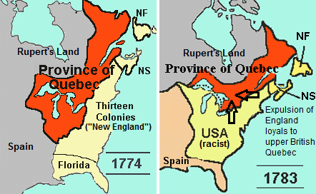
TREATY OF VERSAILLE
Cenored

Slide 7
Consequences of the American Revolution for Quebec
It demonstrated that the policies established by Governor Carleton in 1774 were not exactly successful.
When the Americans invaded Quebec in late 1775, the habitants remained neutral despite urgings from church leaders to fight with the British against the American invaders.
The Ohio Valley became part of the United States of America forcing fur traders from Montreal to shift to the area northwest of Lake Superior.
In 1783, Montreal fur traders founded the North West Company to compete with the Hudson 's Bay Company.

Slide 8
COMING OF THE LOYALISTS
This one of the most important consequence of the American Revolution
Thousands of Loyalists, (Americans who had remained loyal to the British crown during the American Revolution, including many Blacks) came to British North America
About 6000 Loyalists settled in Quebec increasing Quebec's English population. Their arrival leads to the eventual passage of the Constitutional Act in 1791.
changes Quebec population from 99 percent French 1 percent English to 90 percent French and 10- percent English

Slide 9
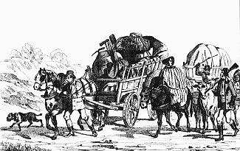
Loyalists being expelled to Canada

