Slide 1
80’s and 90’s

Slide 2
Rene Levesque (PQ) 1980-1985

Slide 3
Robert Bourassa (Lib.)1985-1994

Slide 4
Jacques Parizeau (PQ)1994-1995

Slide 5
Lucien Bouchard (PQ) 1995-2001

Slide 6
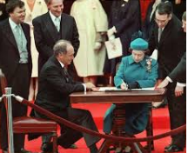
Constitutional Question 1982
The repatriation of Canada's constitution and the signing of the Constitution Act in 1982 without the ratification of the government of Quebec
Meech Lake Accord (1990) attempts to have Quebec sign the constitution and fails
Charlottetown Accord (1992) is the second attempt to have Quebec sign the constitution and it also fails
These failures make Quebec feel unwanted in Canada and leads to the referendum of 1995

Slide 7
Referendum 1995
Shortly after assuming office in September 1994, the Parti Québécois government, led by Jacques Parizeau, drafted a law for a new referendum and then held public hearings on this draft law during the winter of 1994-1995.
On June 12, 1995 three political parties signed an agreement to work together and to promote the “Yes” option
1) the Parti Québécois led by Premier Jacques Parizeau,
2) the federal Bloc Québécois led by Lucien Bouchard
3)the Action démocratique du Québec led by Mario Dumont.
. The "No" forces were led by Quebec's Liberal leader, Daniel Johnson.

Slide 8
No Rally 1995

Slide 9
Question
Premier Parizeau released the referendum question on September 7.
Do you agree that Quebec should become sovereign, after having made a formal offer to Canada for a new economic and political partnership, within the scope of the Bill respecting the future of Quebec and the agreement signed on June 12, 1995?

Slide 10
The VOTE
The vote was held October 30 and 93 % of Quebec's electorate participated .
The results were as follows:
50.6% of the total electorate voted NO
49.4 % of the total electorate voted YES
Numbers are in question as there were many No votes discounted
about 60 % of Francophones voted YES and
over 90% of Anglophones and allophones voted NO.

Slide 11
Result
On referendum night, in a speech to his supporters, Premier Parizeau blamed "money and the ethnic vote" for his defeat.
The next day, Premier Parizeau resigned from office and was eventually replaced by the leader of the Bloc Québécois, Lucien Bouchard

Slide 12
Post Referendum
After the slim win by the No forces, Jean Chretien asked the Supreme Court to determine if a province could separate.
The Supreme Court responded that a province could separate if the question was clear and that a clear majority was held
The federal government then adopted the clarity act in 2000
It maintained that federal government needed to approve the question and stated that a majority was 75 percent and not the 50 percent plus one the provincial government requested

Slide 13
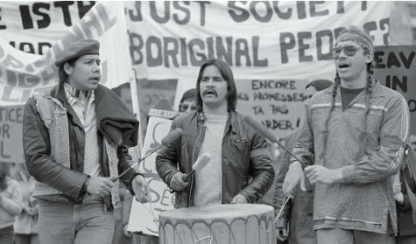
Indigenous Rights 80’s
In the 80’s the indigenous people took a more forceful approach with the government
They relied on court decisions to legitimize their demands for greater autonomy
Constitutional Act 1982: Section 35 recognized the ancestral rights of Amerindians and stated that the indigenous people were Metis, Indian and Inuit
In 1985 Bill C31 was adopted bringing significant change to the Indian Act
It stated that first nations women who married “non-Indian” partners were considered “Indians” as were their Children, 60 000 people had their rights returned
It also allowed Bands to determine who was an “Indian”

Slide 14
OKA Crisis 1990
The need to deal with the long-standing grievances (self-government, land claims, respect of rights and traditions) of Aboriginal peoples increased in urgency following the events at Oka, Quebec, in the summer of 1990.
On July 11, 1990, Quebec provincial police tried to dismantle a road block set up in mid-March by a group of Mohawks from the community of Kanesatake.
The Mohawks had set up the road block to prevent the nearby town of Oka from expanding a golf course onto traditional burial grounds the Mohawks considered sacred and their own.
One police officer was killed during the raid. For 78 days armed Mohawk warriors faced Quebec provincial police, and later the Canadian Armed Forces, after Premier Robert Bourassa had asked the federal government to send in the army

Slide 15
OKA Continued
In a show of support, Mohawk natives at Kahnawake also blocked the Mercier Bridge during this period.
Towards the end of September, the Mohawks peacefully withdrew from the barricade.
On September 25, 1990, the Canadian government announced a new agenda to improve Canada's relationship with Aboriginal peoples, this strengthened aboriginalism.
The new measures addressed the concerns of Aboriginal leaders, including better progress on land claims settlement, improved living conditions, an improved federal relationship with Aboriginal peoples, and a review of the role of Aboriginal peoples in Canadian society.

Slide 16
OKA Barricade

Slide 17
STAND OFF

Slide 18
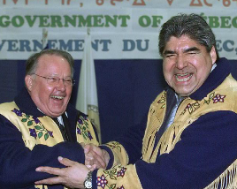
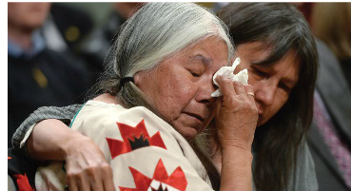
After Oka
1999 Nunavut(our land) (was created from the North West Territories) which allowed the Inuit self governance and was the first time a country changed its domestic borders due to an Aboriginal request
2002 Peace of the Braves: Quebec government agrees to pay the Cree 70 million a year between 2002 and 2050 in return for withdrawal of Cree lawsuits and economic agreement
2008 Truth and reconciliation Commission of Canada was mandated to tell Canada the truth about residential schools

Slide 19
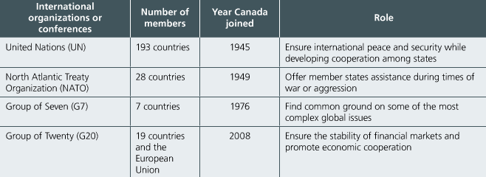
International Relations
With globalization and global events like the fall of the Berlin wall in 1989 there is a greater need for international relations
From peacekeeping to climate change Canada has played an increasing role in international conferences and organizations
These relations have become challenging in an increasingly complex world

Slide 20
Canadian Armed Forces Abroad and Terrorism
The Canadian Armed forces missions abroad were an important part of Canada’s international relations
They took part militarily and also helped in rescue missions, surveillance, providing and protecting supplies, training armies and peace keeping
In 2001, Sept 11, America Declared war on terror and attacked Iran by the end of 2001 Canada joined this war and continues to be involved abroad

Slide 21
Economics 80’s and 90’s
Role of the state changes since heavy public debts prompt the government to reduce its involvement in the economy.
Governments now struggle with continuing deficits and attempt to balance their budgets leading to huge cuts in the health and education sectors.
Many multinationals, political parties and certain financial circles suggest Neo-Liberalis: advocates l’aissez faire economics and an end to state intervention
Crown Corporations become privatized and the government attempts to downsize itself

Slide 22
Unionization
Unions see their influence diminish. The recessions of 1981 and 1990 and the accompanying high unemployment rates force unions to be more conciliatory and less combative.
In some cases workers had to take wage cuts to preserve their jobs.
The rate of unionization peaks at around 40% of the labor force since many of the new jobs are created in the service sector.

Slide 23
Economics 80’s and 90’s Continued
Canada signs a free trade agreement with the United States in 1989 which was expanded in 1994 to include Mexico.
Quebec strongly supported the free trade agreement.
Quebec based companies such as Bombardier, Banque Nationale, Cascades expand their foreign operations and compete in the international market place.
Hydro-Québec construction projects in the James Bay area are stopped after several court battles with the Native community.

Slide 24
Globalization: Free Trade Agreements
More and more trade since the 80’s is done internationally this is known as the globalization of markets
Free Trade agreements allow Canada to trade on equal footing with trade partners and reduce trade barriers and quotas
In 1989 Brian Mulroney a Usa-Canada free trade was concluded
In 1992 Mexico joined this agreement creating NAFTA

Slide 25
Impact of Globalization
In the 80’s and 90’s economic globalization accelerated and increased international trade
Globalization also created competition between countries causing countries to sell their products at lower prices
This causes a debate on whether globalization is positive or negative
One side says that globalization is an opportunity for countries to increase production and improve the standard of living
Others see it as a force that causes job loss as it causes companies to move production to countries where labor costs less money

Slide 26
Economy and Social Justice
Neo-Liberalism led to many protests
People complained not only of the lack of interventionism but also the government inaction in the face of social inequalities and the gap that was growing between the rich and the poor
Due to protest and petitions in 2002 the Quebec government passed An Act to combat poverty and Social exclusion and in 2007 the Social solidarity program
These are predicated on the idea of distributing financial assistance to those that can not work
People also took part in the social economy through coops and businesses not run for profit but for the good of the community

Slide 27
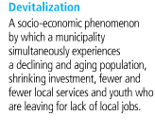
Devitalization of Communities
Urbanization continues to grow in this time period causing many outlying regions to suffer devitalization
Single industry towns: Depletion of a resource or a recession can cause people(youth) to leave due to a lack of jobs, this can be aided by economic diversification
Migration: often leads to a reduced and aging population
Services also become increasing centered in cities, while a decline in population of small communities can lead to a loss of services, thus increasing devitalization
Population equals political power: thus less people means declining political power for these regions

Slide 28
Language Debate: BILL 178
In 1988, the Supreme Court of Canada declared that unilingual French signs, as stipulated in Bill 101, were unconstitutional.
To counter this, Premier Bourassa uses the notwithstanding clause, found in the 1982 Constitution, allowing him to ignore the ruling and introduce Bill 178.
The law maintained
French-only exterior signs and
provided for bilingual indoor signs so long as French predominated.
Five years later, in 1993, the provincial government replaces Bill 178 with Bill 86.

Slide 29
Language Debate: BILL 86
The Bill amended Section 58 of Bill 101 to allow for bilingual exterior signs so long as French predominated.
In October 1999, a Quebec court ruling struck down Section 58 of the French Language Charter, Bill 101, that says French must be predominant on commercial signs.
The Court stated that the Quebec government must now re-prove in a court of law the continuing fragility of French in order to justify continuing restrictions on the use of languages other than French on signs.
The provincial government has said it will appeal the ruling.

Slide 30
OTHER Important Events
The adoption of the Canadian Charter of Rights and Freedoms, which became part of the Constitution of Canada in 1982.
Immigration policies, especially with regards to principal continent of origin, which have brought about a more Multicultural society in Quebec and Canada.
Women now participate more and more in public and economic life.
The majority of women now work outside the home running businesses and working in responsible positions.
Wage equity is becoming a major issue for women. 2006 the Pay equity act was passed
Law on Family Patrimony (1989) was passed ensuring that property was divided equally between spouses after a divorce or death.

Slide 31
Culture
In 1992 Quebec created its cultural policy
3 main goals: 1) Affirmation of Identity, 2) Support for the Arts 3) Citizen access and participation in cultural life
This led to an increase of funding for the arts
Quebec created 2 crown corporations to fund cultural pursuits CALQ and SODEC
Transmission of Quebec’s art and identity to the world remain an important idea

Slide 32
Low Birth Rate
To raise falling birthrate (see population notes) Quebec adopts several measures.
The create child care centers or CPE’s in 1992
Quebec Parental Insurance Plan in 2006
Immigration has helped low birth rate

Slide 33
Information Age
In the 90’s with many inventions in the communications field Quebec was launched into the information age
Internet
Dissemination of digital content allows more people to transmit their ideas and receive ideas from the global community
People fear that control of information is become centralized in the hands of the few due to large scale mergers limiting the voice of the people

Slide 34
GOOD LUCK ON YOUR EXAMS
THE END

