Slide 1
ACT OF UNION
1840-1867: Second to last Constitution of the British Regime

Slide 2
Act of Union
Act of the Union was passed in Britain in 1840
It unites Upper and Lower Canada into the province of Canada
It was a legislative union where one government controlled the whole area

Slide 3
Act of Union Map 1840

Slide 4
Government Form: Act of Union

Slide 5
Form Continued:
There were to be 84 seats in the legislative assembly (42 from each of the Canadas, even though Upper Canada had more people)
The legislative council was to be appointed for life with members of both Canadas.
Public debt was to be combined (Upper Canada had 12 times the debt of Lower Canada)
Laws and rights remain unchanged but English is the official language so all debates must be in English

Slide 6
Political Changes
This creates a united Canada where the French are the minority
After the rebellions moderate leaders take over
Robert Baldwin from Upper Canada and Louis Hyppolyte Lafontaine from Lower Canada find that by working together they can accomplish what they want
The French supported English building projects while the English accepted French in the debates
They also agreed to push for responsible government together

Slide 7
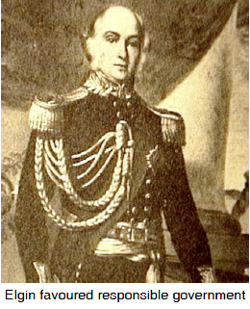
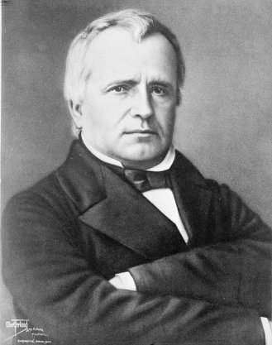
Moderates that Championed Responsible Government
Louis Hypolite-Lafontaine
Robert Baldwin

Slide 8
Drive for Responsible Government
In 1848 Lord Elgin accepts the principle of Responsible government
The head of the assembly was to act as a prime minister with executive powers
This prime minister could then choose members from the assembly to be on the executive council
If the cabinet lost the confidence of the majority it had to resign
Elgin promised to not use his veto or appoint officials

Slide 9
Form of Responsible Government: 1848

Slide 10
First Challenge to Responsible Government
The first law the new government passed was the Rebellion Losses Bill
This law forgave the patriotes involved in the rebellions of 1837 and made retribution for the monetary losses of people during that same time.
The “Tories” upset by this law riot in 1849 and burn down the parliament buildings in Montreal at Youville Square
The governor’s carriage is also attacked
Lord Elgin refused to call in the army or use his veto on the law
This ensures responsible government in Canada

Slide 11
Parliament of Montreal

Slide 12
1848-1850’s
Between 1848 and the 1850’s many useful laws were passed as the two sides worked together
1851: Britain transfers control of the postal system to Canada.
1851: For the first time, the population of Canada-West (Ontario) surpasses the one from Canada-East (Québec).
1852 : Creation of the Université Laval, first French-speaking institution of higher learning on the continent. It receives its Royal charter on the 8th of December 1852.
1854 : The seigneurial regime is officially abolished.
This led the French Canadians to feel less threatened as they had some say in the government

Slide 13
What economic changes took place following the Act of Union ?
Great Britain rejected economic protectionism and adopted free trade in 1846 which meant that British North America's export products were no longer protected by favorable British tariffs.
Canada's export trade was reduced considerably since her wheat and timber now had to compete in an open market with products from other countries.
To make up for the loss of the British market the British North American colonies signed a ten year Reciprocity Treaty with the United States in 1854.

Slide 14
Reciprocity Agreement
provided free entry (no tariffs) for the natural products (wheat, fish, timber, coal) of each country into the markets of the other.
allowed both countries free access to each other's fisheries.
allowed Canada free navigation on Lake Michigan and the United States
the same privileges on the St. Lawrence River.

Slide 15
Further Improvements to transportation
More canals were built and deepened and more railways were built between 1850 and 1860.
The Grand Trunk Railway stretched from Sarnia to Riviere­ Du-Loup and the St. Lawrence & Atlantic Ocean connected Montreal to Portland, Maine

