Slide 1
Champlain: The Father of New France
The beginning of the French Regime

Slide 2
Economic Reasons For New France
France's main interest in North America was economic
As long as the fisheries were the most lucrative resources and after the failures of Cartier, France lost interest in N. America
In the l 600's the demand for furs changes this, causing the king of France to renew his interest in N. America
Due to his lack of funding he made a deal with merchants for Monopoly trading rights in return for colonization

Slide 3
First attempt at Settlement
The first to receive trading rights to the Atlantic region in Canada was Pierre du Gua de Monts
He was given these rights in return for a promise to settle 60 men a year for 10 years
In 1604 de Monts and 78 colonists (one of which was Champlain) wintered on an island near the border of Maine
The winter defeated this attempt with 35 men dying of scurvy
He then moved the remainder of his men and new colonists to the Annapolis valley
This settlement was named Port Royal
The help of the Amerindians proved invaluable but de Monts lost his monopoly in 1607

Slide 4
Champlain and the 100 Associates
In 1608 Champlain went to France and convinced the aristocracy to invest in North America
He convinced them that the settlement would pay dividends through a NW passage to the Orient and Mineral discoveries
Due to his efforts a new monopoly was created with Champlain as its lieutenant
Champlain learned from the first trial that he needed a more central location and Amerindian aid if he was to succeed
He created his settlement where modern day Quebec City resides and called it L’Habitation

Slide 5
Champlain is known as the Father of new France
Champlain during his life explored and Mapped much of the St. Lawrence area
Although Champlain was never the official Governor of the colony he was responsible for civil administration, enforcing the King's law, and overseeing relationships with Amerindians
He also invested a lot of money into the settlement and convinced people in France to do the same

Slide 6
Colonial Canada
A colony is a land which is settled and ruled by another country
During the time of Champlain there were 2 views of colonization

Slide 7
View 1: Trading Colony
The first view was that colonies were only there to enrich the home or mother country (mercantilism)
They did not believe in building a society but in exploiting the resources of the new land
This was the idea shared by the companies given monopolies in North America and the Kings of France, Portugal and Spain
Since the Companies saw Canada as a source of furs they did not want settlements as they would chase away fur bearing animals and compete with securing the resource
Thus, they only wanted a small number of outposts which could be run by a minimal amount of people

Slide 8
View 2: Settlement Colony
Other people including the religious orders wanted a colony which was settled and developed in as close a copy of the home country as was possible
This model of colonization called for as many farmers, merchants, priests, soldiers and administrators as possible
They wanted the colony to be as successful as possible

Slide 9
Historical Result
France followed the first path while Britain followed the second
France created several outposts along the St. Lawrence and named these areas New France
The British created 13 colonies which consisted of many towns and villages
The British gained much wealth because they were able to collect many taxes and had a larger work force to exploit natural resources
In 1663 the King takes direct control of New France to change it into a settlement colony

Slide 10
What is mercantilism?
Mercantilism was an economic policy, popular in the 17th and 18th centuries in Europe
stated that a country's wealth and power was best served through the accumulation of gold and silver and raw materials.
Because most nations did not have a natural abundance of such precious metals, the best way to acquire them was through trade.
This meant striving for a favorable trade balance, that is, a surplus of exports over imports. Foreign states would then have to pay for imports in gold or silver.
State action, an essential feature of the mercantile system, was used to accomplish its purposes - to sell more than it bought to accumulate gold bullion and raw materials.

Slide 11
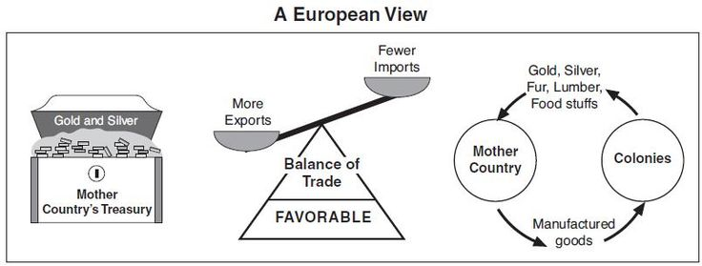
New France's Mercantilism
In the case of New France, fur was the raw material.
France imported raw materials, such as furs, from its colony New France
Then transformed them into finished products (beaver hats) to be sold back to the colonies and to other countries.

Slide 12
Consequences of mercantilism on New France
New France became a trading colony whose main economic role was to supply furs to the mother country and to purchase manufactured products from the mother country.
This limited the types of Companies that could be run here and kept New France dependent on France
Furs account for more than 70% of the colony's exports and the fur trade is directly responsible for the large expansion of territory

