Slide 1
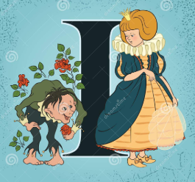
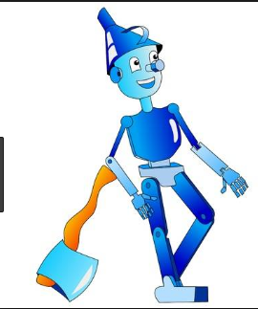
Characters

Slide 2
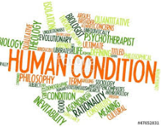
Definition
Writers create fiction to explore the human condition and they use characters to drive this exploration
Understanding humanity is the aim of Literature
So understanding Characters is of the utmost importance to finding meaning in a piece of literature
Character: verbal representation of a human being
Each Action or speech is important to understand the complexity of this exploration

Slide 3
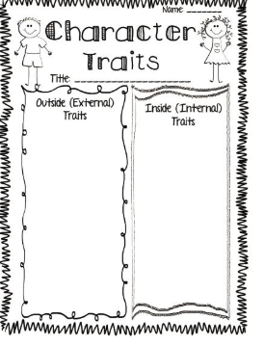
Circumstance VS Traits
You must always determine the difference between a trait and circumstance
Circumstances are only important if they give you insight to the important traits of a character or if they allow the character to act against a trait
If I win the lottery that is not a trait it says nothing about me as a person…but spending a 100 dollars a week trying to win the lottery does say something about who a character is
Always work from the outside toward the inside as it is what is inside that creates the outside reality

Slide 4
Characters: People in Fiction
Flat Characters
Round Characters
Round characters grow and change through out the story
The never end where they begin as a general rule
Often known as the protagonist(main character) and combats the antagonist
Flat characters do not change through out the story
They end where they begin
Characters that are prominent and repeat ie: a bumbling sheriff or Wise old woman are known as stock characters

Slide 5
5 Ways Character is revealed
Actions
Descriptions
Statements
What they say and think.
You also have to determine if they are trustworthy or fooling themselves
What they do.
Appearance and Environment can tell us a lot about a person
Poverty vs Wealth come with generalizations

Slide 6
5 Ways Character is Revealed cont’d
Statements of other characters
Statements made by the author/Narrator
What is said about them by other characters
Also needs to be explored for meaning and authenticity
Statements by authors or narrators are usually factual
Some authors will be unreliable however

