Slide 1
Confederation
Making a Country

Slide 2
Charlottetown Conference September 1864
In September, representatives of the Maritime colonies went to Charlottetown to discuss a Maritime Union.
The leaders of the colony of Canada asked to be invited to suggest instead a larger scheme of union
The wanted a confederation of the Maritime colonies and the colony of Canada.
Representatives from Canada, both Canada East and West, Nova Scotia, Newfoundland, and New Brunswick attended.
It was decided to continue the talks the following month in Quebec City.

Slide 3
Quebec Conference: October 1864
The Quebec Conference was a serious discussion of the specific details of Confederation. A major point of contention was whether the new country should have:
1) a legislative union where all the laws are made by the central government or
2) A federal union where the central government makes some laws, but the provinces make their own laws for local matters.
John A. Macdonald preferred a legislative union because he saw how a federal union in the USA had led to civil war.
However, it was decided that the new country would have a federal system of government so that Quebec and the Maritimes could maintain control over local affairs.

Slide 4
Other decisions at the Quebec Conference
Quebec, especially did not want to lose control over language and religion.
It was also decided that
1) the House of Commons would be elected using representation by population
2) there would also be an appointed Senate with equal regional representation
3) Parliament would be made up of three parts, the elected House of Commons, the appointed Senate, and the monarch, represented by an appointed Governor-General.

Slide 5
Reactions to the 72 Resolutions
At the end of the Quebec Conference the delegates drew up a list of seventy-two recommendations called the Quebec or the 72 Resolutions.
The political system adopted at Quebec City is very similar to the system we still have in Canada today, though much has been added to it.
Reactions:
French Canadian delegates accepted the terms of Confederation because the province would have control of local affairs, specifically education and religion.
French culture would thus not be threatened by the bigger English population.
However, les Rouges, led by A.A. Dorion, claimed that Confederation would mean the end of French Quebec.

Slide 6
Reactions continued
Canada West was happy because George Brown got rep by pop, and the province would be able to dominate affairs in the new country.
The dead lock of the previous years would be over.
Delegates from the Maritimes were not so happy because they ·would have little power in the federal government, as they were so much smaller than Ontario and Quebec in population
However, like Quebec, they were happy they would be able to keep control of local matters.

Slide 7
Getting the Legislative Assemblies of the Colonies to Pass the Quebec Resolutions
The delegates would have to explain these recommendations to the assemblies in each colony and persuade them to pass them, so that they could then ask the British government to approve the plan for Confederation .
Thanks to the Great Coalition, the plan was swiftly passed in the united Canadas.
There was much opposition in the Maritime colonies:
1)Newfoundland and PEI were not interested from the start.
2) New Brunswick electors voted Tilley out of office for a while, and Tupper had to face the determined opposition of Joseph Howe in Nova Scotia.
Eventually, both Colonies voted for confederation.
Fenian raids in New Brunswick showed how weak that colony would be if it tried to stand alone.

Slide 8
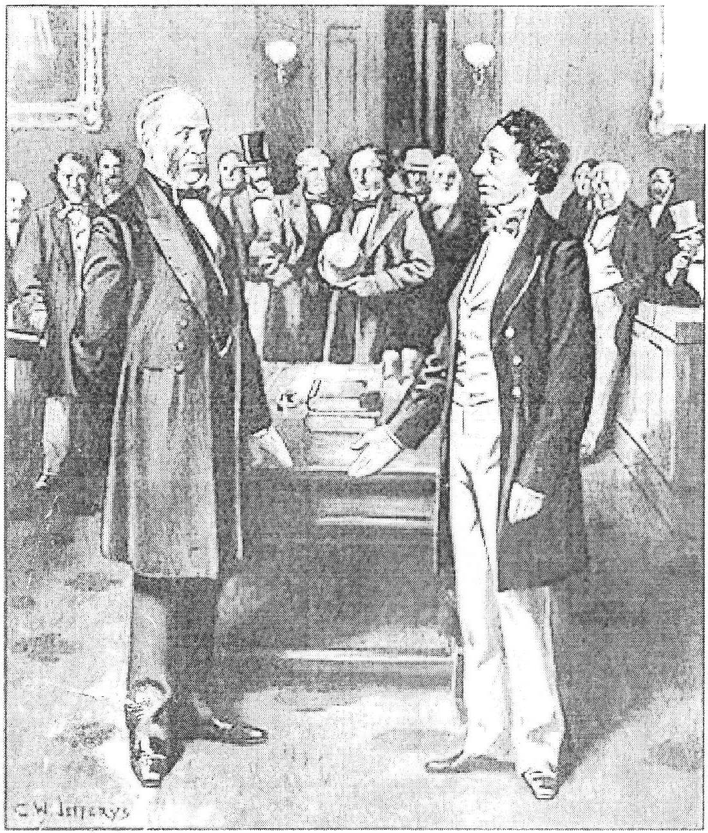
London Conference: 1866
In 1866, delegates from the three colonies traveled to London, where the British government approve the plan for confederation.
A law of the British parliament acted as the constitution of Canada, this fact was to cause trouble later, when Canada wanted to have its constitution as a Canadian Law, not a British one.
On July 1, 1867, the British North America commonly called the BNA Act was proclaimed.
The original Dominion of Canada had four provinces, Ontario, Quebec, New Brunswick, & Nova Scotia, but the BNA Act looked forward to including British Columbia and the lands of Hudson's Bay Company.
As we can see from Its motto, A mari usque ad mare, From sea to shining sea.

Slide 9
Key Characteristics of the BNA Act
The British North America Act established a federal political system of government in Canada with a central government in Ottawa and provincial governments in the four original provinces Confederation.
The most important aspects of the BNA Act are contained in Sections 91 and 92 of the constitution which outline federal and provincial responsibilities or powers.

Slide 10
Section 91 and 92 of the Canadian Constitution
Section 91 (Federal) Section 92 (Provincial)
Defense Education (Section 93)
banking and money municipal institutions
postal service hospitals
criminal law property and civil rights
Immigration and agriculture were shared responsibilities between the federal and provincial governments.
The federal government could also disallow any provincial law if it felt it was not in Canada's interest.
John A Macdonald instituted a clause that stated any new idea not on the list automatically entered federal jurisdiction.

