Slide 1
Causes of Confederation
Creating a need for a country

Slide 2
Why was there political deadlock in the United Province of Canada during the 1850s and 1860s?
In the period after the acceptance of the principle of responsible government, governments in Canada were very short-lived and insecure.
Between 1854 and 1864, there were 10 different governments and no government lasted long enough to give the colony political stability.
the political system produced several equal groupings in the assembly, and the political instability which developed led to political dead lock
Deadlock is a situation where no one can move or win in government, this paved the way to Confederation.
There were four main political parties: 2 radicals and 2 moderates
Radicals are at the extreme of an argument and moderates are trying to find common ground between the arguments

Slide 3
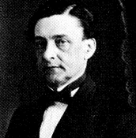
Radical Party Lower Canada: Les Rouges
.
led by A. A. Dorion, who drew their support from French Canadian nationalists.
French Nationalist/ anti-English
Nationalism: The strong belief that the interests of a particular nation-state are of primary importance. Also, the belief that a people who share a common language, history, and culture should constitute an independent nation, free of foreign domination

Slide 4
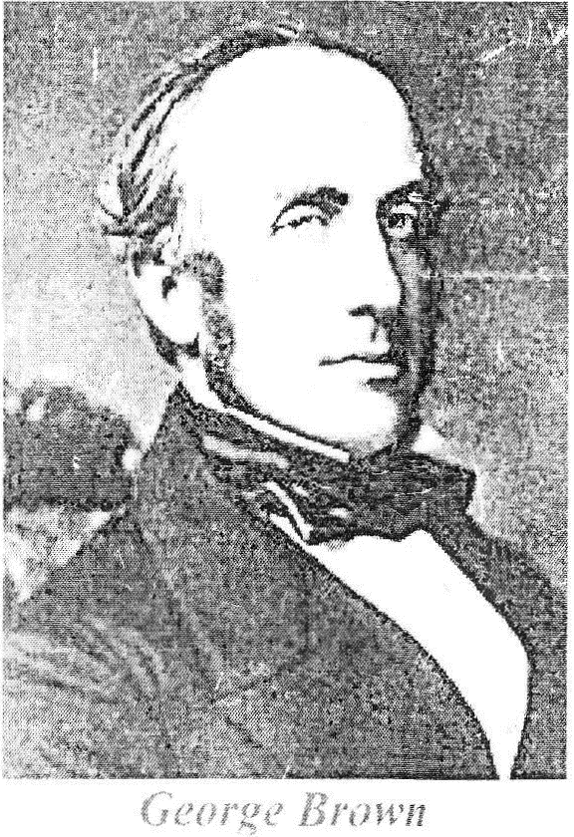
Radical Party Upper Canada: Browns, Liberals or True grits
Liberalism: Political and ideological belief that all individuals have equal rights and protection from the law
George Brown believed that the way to break the deadlock was to recognize the greater population of Canada West in the electoral system.
He demanded "rep by pop" (representation by population) as the basic principle for any new political arrangement.
It would in effect give Canada West more MPs, and therefore more power than Canada East.

Slide 5
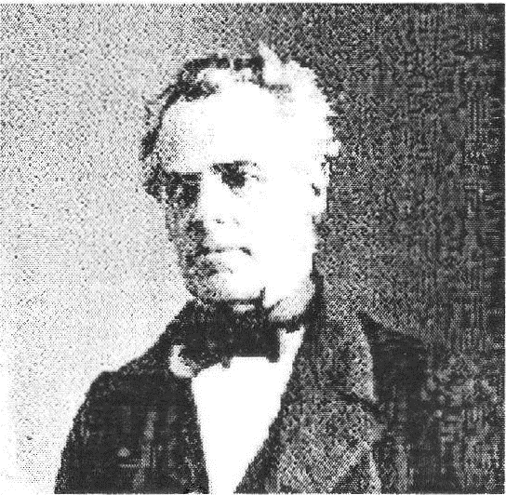
Moderate Party Lower Canada: Les bleus
Led by George Étienne Cartier

Slide 6
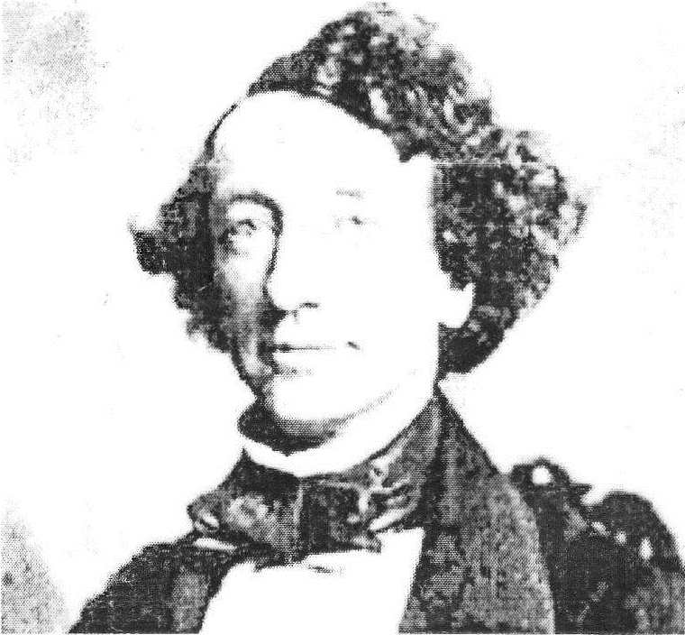
Moderate Party Upper Canada: The conservatives, Tories
Led By John A Macdonald.

Slide 7
The Great Coalition
In 1863, George Brown agreed to work with John A. Macdonald and George-Etienne Cartier, Macdonald's partner from Lower Canada, to make major changes
This is called a coalition: which is a political alliance of two or· more political parties who agree to vote together in parliament
The problem was to develop an arrangement which would not leave Lower Canada as a less important part of the colony since Upper Canada was larger
One way to do this was to include other colonies in a political arrangement, so that Canada West would be balanced by these other colonies
Various forces from outside were beginning to push Canada and Britain's other colonies in North America together into a confederation.

Slide 8
The American Threat
The British colonies of North America felt threatened by the United States.
The USA believed in Manifest Destiny, which is a belief that all of North America should belong to the United States
The Americans had the American Civil War (1861 - 1865).
Canadians were afraid the Americans would invade Canada in retaliation for Britain's actions and support of the Southern states during the course of the Civil War.
A further threat was posed by the Fenians, Irish nationalists, who wanted independence from Britain. They had a lot of support from Irish Americans.
The Fenians wanted to capture the colonies in Canada and use them to force Britain to give Ireland its freedom.

Slide 9
Trade
In 1854, the British North American colonies had signed a Reciprocity Treaty with the USA for a ten-year period.
In 1865, the American government decided to end the treaty.
The British North American colonies now intensified efforts to establish inter-colonial trade to offset the loss of the American market.
Union of the colonies could remove tariffs and trade barriers between them and promote trade by creating a larger home market.

Slide 10
Railways
The construction of an inter-colonial railway between Canada and the Maritimes was necessary since all goods were being transported on American lines (see American Threat)
Also, the Canadian railway: The Grand Trunk Railway needed increased traffic on its line to avoid bankruptcy.
In addition, a transcontinental railway uniting the Atlantic to the Pacific would have to be built to open up the West and to prevent a possible takeover by the United States.
Railway construction however was extremely expensive.
The only way to ensure its construction would be for all the colonies to unite and to contribute to its construction.

Slide 11
British Attitude
Without Britain's permission Confederation was not possible
The British at this time were interested in seeing the colonies unite, because the cost of defence could be taken over by the colonies.
To the British, it made good sense for the colonies to join together to make a larger union, which would be strong enough, with some support from Britain, to stand up to the United States.

