Slide 1
Culture

Slide 2
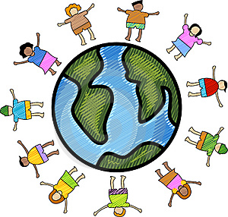
Culture in all its forms
Quebec is a pluricultural society
Shared traits allow diverse cultures to live together
The most prevalent shared traits in Quebec are
1) Common Language
2) Ideas in motion/common values
3) diversified art production

Slide 3
Common Language
French language is a shared cultural trait
Language connects the French to their history
Allows them to be a part of the global French community

Slide 4
Ideas in motion/common values
Several currents of thought in Quebec:
The French people of Quebec are political and focus on their rights and social justice
They protect these rights through the law and citizen groups

Slide 5
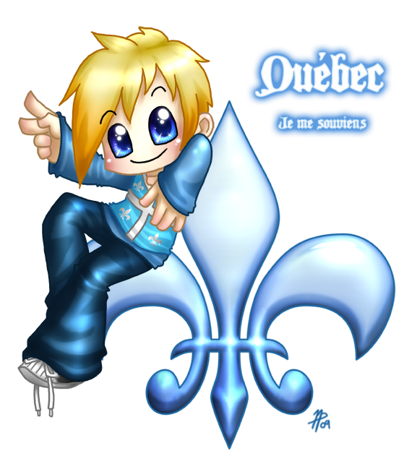
Diversified art production
Art is the most important expressions of Quebec culture
Quebec artists are going global and spreading Quebec culture

Slide 6
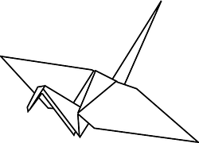
Transmission of culture
Culture needs to be transmitted in order to survive
Families play an important role in this through language and traditions passed to children
State also transmits culture by having policies that support the culture and paying for the arts

