Slide 1
Debates

Slide 2
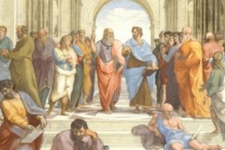
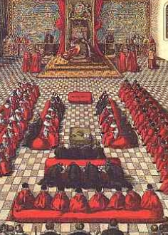
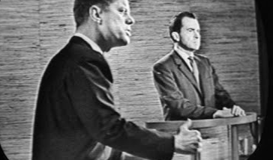
Debate through the years taken from :https://sites.google.com/a/westlakeacademy.org/wa-debate-club/home/debating-overview/history-of-debating
Modern Debate
Earliest Debates
Development
Medieval England saw the rise of Parliament in order to aid the Kings. In fact Parliament is derived from the French word parler, "to speak". As Parliament evolved it became a place of debate and policy.
In the 1960 Presidential election, debates were televised. Famously, those who listened to the radio thought Richard Nixon had won, while those who watched on television believed the more charismatic John Kennedy had won. Kennedy's election victory is often attributed to his performances in these debates.
In ancient Greece, the philosopher Socrates used debate as a way of understanding the world by drawing out answers from his followers.

Slide 3
What makes a good debater?
Debate allows us to consider the world around us by thinking about different arguments, engaging with opposing views and speaking strategically.
Typically, judges decide how persuasive debaters have been through three key criteria:
Content: What we say and the arguments and examples we use.
Style: How we say it and the language and voice we use.
Strategy: How well we engage with the topic, respond to other people's arguments and structure what we say.

Slide 4
Conducting the Debate
Debate opens with the pro team (the team that supports the resolution) presenting their arguments
This is followed by a member of the opposing team.
This pattern is repeated for the second speaker on each team.
There is a slight recess for a strategy session to formulate the rebuttal
Finally, each team gets an opportunity for rebutting the arguments of the opponent without adding new information to your own argument.
Speakers should speak slowly and clearly. The judges and members of the audience should be taking notes as the debate proceeds

Slide 5
Timings: Opening arguments
Speaker 1 Pro: 3-4 Minutes
Speaker 2 Con: 3-4 Minutes
Speaker 3 Pro Second Chair: 2-3 minutes
Speaker 4 Con Second Chair: 2-3 Minutes
5 minute recess

Slide 6
Rebuttal and closing arguments
Speaker 5 Con Third Chair rebuttal: 2 minutes
Speaker 6 Pro third chair rebuttal: 2 Minutes
Con closing remarks: 1 minute
Pro closing remarks: 1 minute
Question Period: 5 minutes
Adapted from https://www.cus.org/members/debating/what-debating and https://www.edu.gov.mb.ca/k12/cur/socstud/frame_found_sr2/tns/tn-13.pdf

