Slide 1
Economic changes during the Constitutional act

Slide 2
Timber Trade
The Napoleonic wars created a tremendous demand for timber to build British warships (War of 1812); however, a blockade of French ships prevented England from buying wood from the Baltic States (Estonia, Latvia, Lithuania).
As a result, England turned to Canada, where a seemingly inexhaustible supply of wood was available.
Timber, helped by preferential British tariffs, accounted for over 70 % of the exports to Great Britain.

Slide 3
Fur Trade
The fur trade went into a steep decline.
In 1770, over 75% of Quebec's exports to Great Britain were furs.
By 1810, furs accounted for only 9% of the exports of Upper and Lower Canada.
This is not connected to the timber trade increasing in importance

Slide 4
Transportation
Canals were built to improve transport and trade between Upper and Lower Canada.
The construction of canals allowed steamships such as the Molson Accommodation to sail on the St. Lawrence.
The first railway built was completed in 1836 and joined La Prairie to Saint – Jean.
Both of these allowed for reliable transportation of goods and aided the economy
Trains allowed for settlement away from the waterways over time.

Slide 5
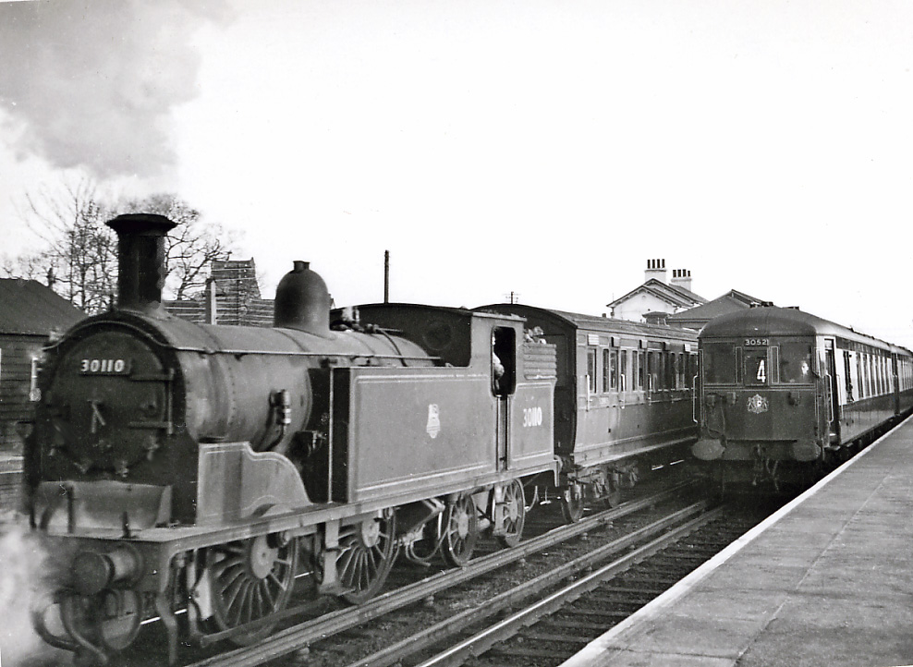
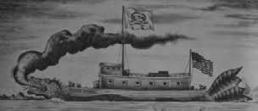
Transportation
Trains
Steamships

Slide 6
Agriculture
Agriculture, in particularly wheat production, gradually declined in Lower Canada.
After 1830, it was unable to meet foreign demand and it began to import its wheat because of poor harvests, outmoded methods and soil depletion.
This is called the agricultural crisis of the 1830’s
Overcrowded seigneuries made the situation worse.

Slide 7
Finance
The Bank of Montreal, Canada’s first major bank was incorporated in 1817 and became the prime focus of early nineteenth century Canadian business and finance.

