Slide 1
French Society
NEW FRANCE

Slide 2
Role of the Church
The Church supported the Government by using its’ influence with the people
The church was influential because of its involvement in the lives of the people
One area we can see this is the belief in Gallicanism
Gallicanism is the belief that the King was equal to the Pope and should have autonomy in France
This theory is why the King was able to establish Absolutism as he was God’s chosen king so the people accepted his absolute command

Slide 3
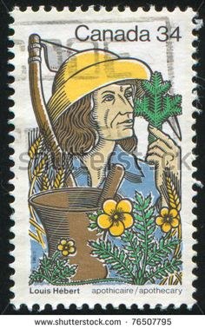
First French Colonists
Louis Hebert is the first settler who came to New France to cultivate the land
He came as an apothecary(expert on medicinal plants)
He was able to clear land on his off time and over time was able to live off the land
Farming did not become popular in New France until it was pushed under the Royal Government

Slide 4
Seigneurial System
Agriculture was the economic activity in which most people worked
established in New France in 1627 and officially abolished in 1854
The Seigneurial system was modeled after the feudal system in Europe and included a system of rights and duties between seigneurs and censitaires (habitants). (Please see hand out for must learn details)
It is a land distribution system: Its aim was to encourage the settlement of New France and to promote the distribution of land.
It also supported the social hierarchy making the Seigneur a privileged class

Slide 5
Characteristics of Seigneuries
A seigneurie was granted to a seigneur.
The seigneur was obliged to rent long lots (concessions)on his seigneurie to tenant-farmers called censitaires (habitants).
The lots were narrow rectangular tracts of land found perpendicular to a river allowing more settlers access to the river.
The seigneur also built roads, a m ill, an oven, and held a court to settle disputes.
In return, the censitaires cleared their lots, paid rent as a portion of their income, in the form of food and produce (cens et rentes), worked 3 days a year without pay (corvée), and paid a tax if they sold their lots.

Slide 6
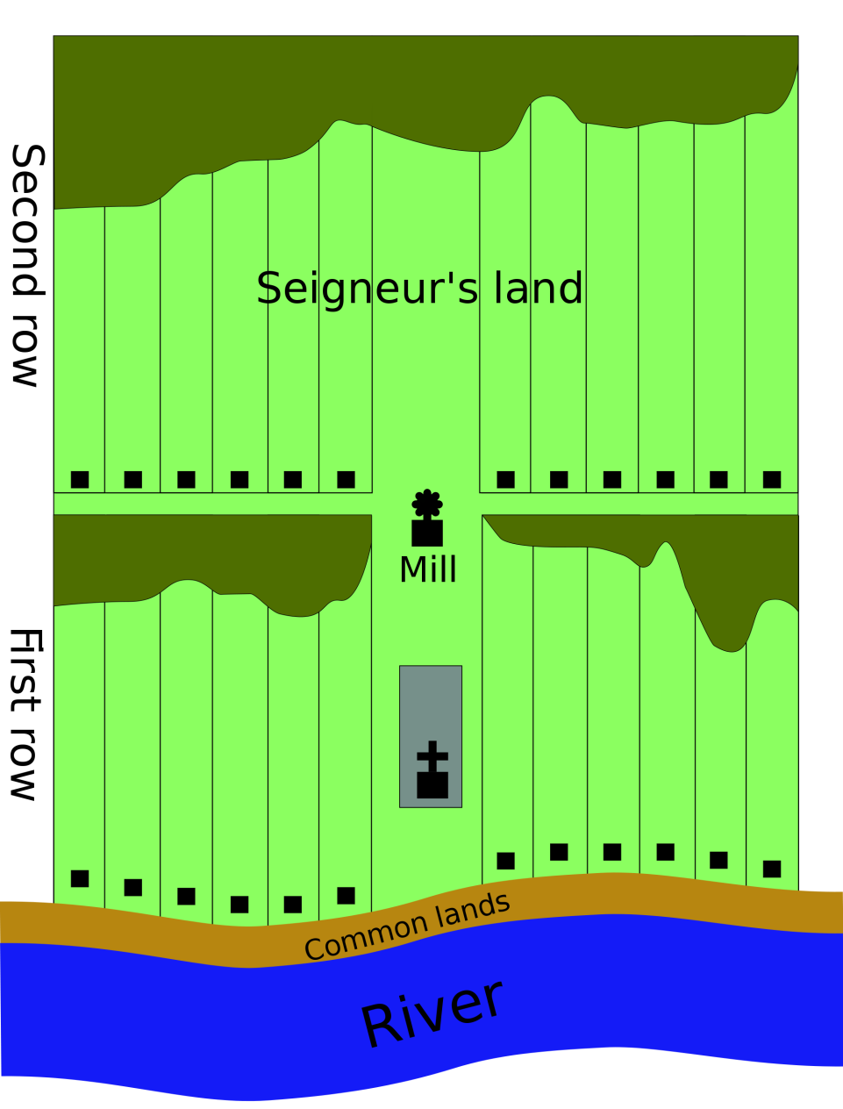
Seigneurial system
Vertical roads are montees and horizontal roads are range roads

Slide 7
Everyday Life In France vs. New France: Social Order
France
New France
Elite: King
Aristocracy
Bourgeoisie: Merchants/officials
Commoners: Peasants (95% of the population)
Strong separation between classes
Elite: Sovereign Council
Merchants
Bourgeoisie: Civil servants
Cures
Seigneurs
Commoners: Censitaires/habitants
Due to a lack of wealthy people and commoners with land, the people of New France were less respectful and more rebellious than commoners in France

Slide 8
Everyday Life In France vs. New France: Commoners Quality of Life
France
New France
Low amounts of food
High Taxes
Crushed By class structure
Plenty of food
Low Taxes
Relatively Independent

