Slide 1
Geography of Eastern North America

Slide 2
Vocabulary
Natural features: include relief, types of rock and waterways.
Relief: refers to the highest and lowest elevation points in an area. Mountains and ridges are typically the highest elevation points, while valleys and other low-lying areas are the lowest.
Animal Husbandry: Farming in which animals are raised for food
Natural Resources: Refers to elements which can be extracted from the soil or environment
River Systems: all rivers and streams (water courses) in a given region
Drainage basin: is when all the water courses flow toward a large body of water
Climate: differences in temperature and precipitation between territories

Slide 3
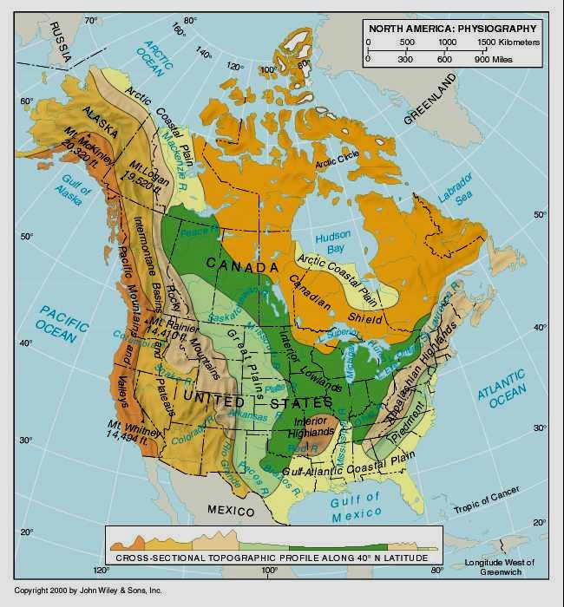
Physiographic Regions
Physiographic Regions influence the lives of the populations that settle there
Physiographic Regions group territories that share similar natural features
These features determine economic activities and cultural heritage
Therefore, geography has a major impact on settlement

Slide 4
MAIN TYPES OF RELIEF
Mountain: significant altitude with a summit and slopes (several mountains are known as a mountain chain
Hill: small rise coming usually from a plain or plateau
Plain: vast flat land with little difference in elevation, often used in agriculture
Plateau: Flat but higher than other land around it, sometimes used for agriculture and animal husbandry
Valley: Low altitude land between elevated land(ie between mountains) usually along watercourses. Fertile lands suitable to agriculture

Slide 5
River Systems
Development of society has always been influenced by the water in the territory of that society
Waterways served as communication channels and trade routes
They also allowed access the interior of the continent where the best resources were
The four entryways to the interior of North America on the east coast are:
1) Hudson Bay
2) The St. Lawrence River system
3) The Hudson/Mohawk River
4) The Mississippi River

Slide 6
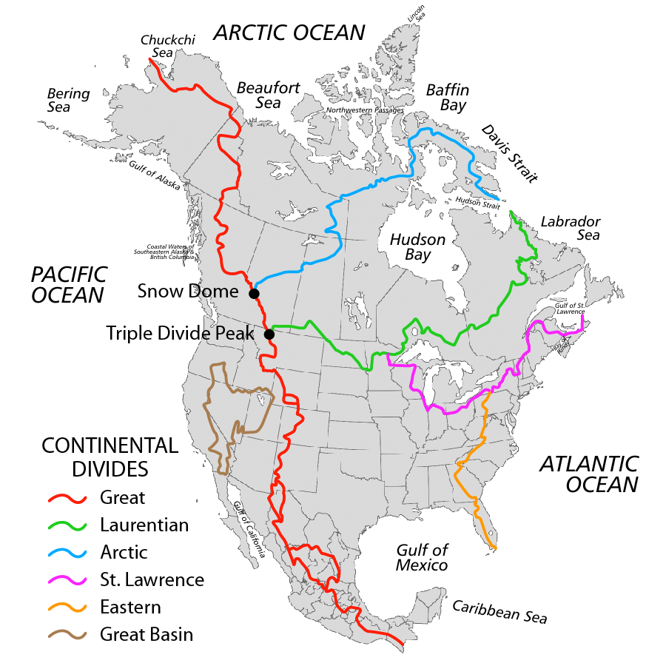
River transportation was the highway of Pre-Confederation Canada

Slide 7
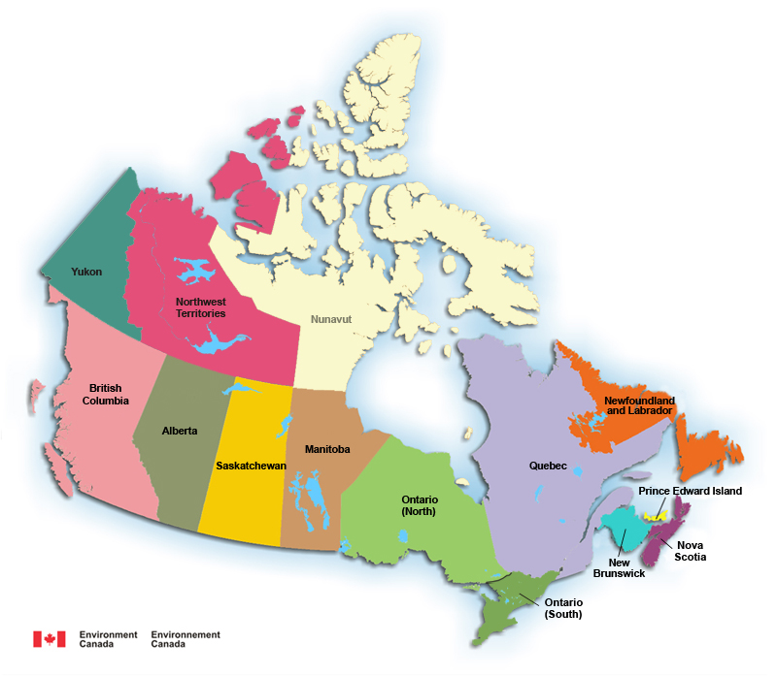
Map of Canada

Slide 8
Canada
Canada has 10 provinces and 3 Territories
There are 5 distinct regions that make up Canada
1) The Atlantic Region (also known as the Maritimes)
2) Central Canada
3) The Prairie Provinces
4) The Western Coast
5) The North

Slide 9
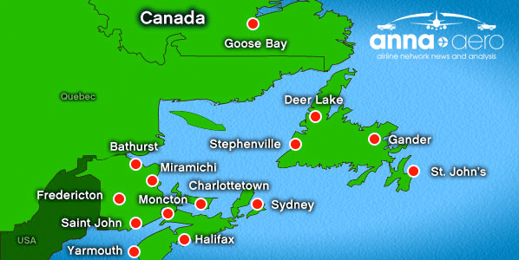
The Atlantic Region (also known as the Maritimes when not including Newfoundland)
Made up of New Brunswick, Nova Scotia, PEI, and Newfoundland
Ocean based economy

Slide 10
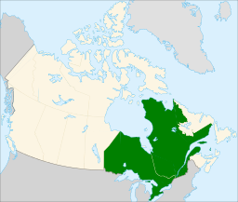
Central Canada
Made up of Quebec and Ontario
Combined, the two provinces have approximately 20 million inhabitants which represents 62% of Canada's population.

Slide 11
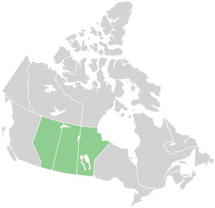
The Prairie Provinces
Made up of Alberta, Saskatchewan and Manitoba
Primary industries include agriculture and cattle and sheep ranching.
Also, natural resources such as the oil sands and oil production can be found on the plains.

Slide 12
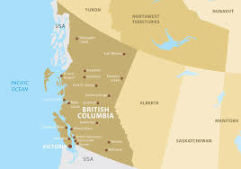
The Western Coast
Consists of British Columbia
BC occupies about 10 per cent of Canada’s land surface
Economy surrounds Agriculture and Tourism
BC has giant Redwoods

Slide 13
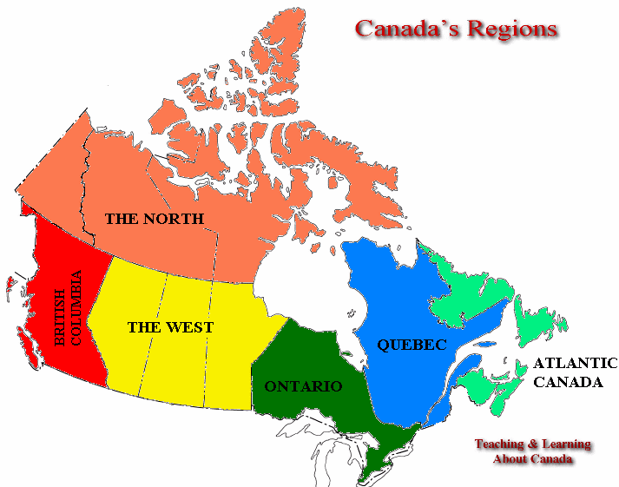
The North
Made up of the Yukon, Northwest Territories, and Nunavut.
This area covers about 39 percent of Canada's total land area, but has less than 1 percent of Canada's population.
For hundreds of years, this area had been considered the largest 'uncivilized' area in the world
However, within the last 20 years, specifically in the last 5 years this area has started to boom with the rest of Canada.
Although it has not been on the same scale, some towns and cities have seen population increases not seen for several decades before.

