Slide 1
The First People
Society Pre-Contact

Slide 2
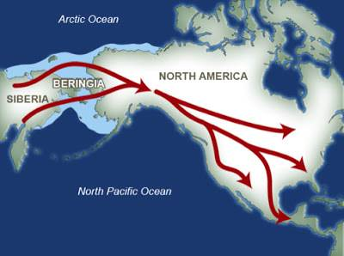
How did the first people arrive in North America?
Where did they originate from?

Slide 3
Beringia
Different theories exist as to how they arrived.
The two most common being:
1) The Land bridge hypothesis (accepted)
2) Watercraft hypothesis (questioned)

Slide 4
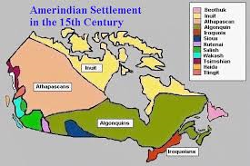
Language Groups
There are three language groups of Amerindians in North America
The Inuit
The Iroquois
The Algonquian

Slide 5
5 Characteristics of the Iroquois
IROQUOIS SEDENTARY LONGHOUSES AGRICULTURE MATRIARCHY ST. LAWRENCE LOWLANDS

Slide 6
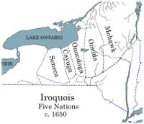
5 nations Iroquois

Slide 7
Politics
The Mohawk and Huron are some of the original five nations to form the League of the Iroquois.
This confederacy or league was formed around1450 - 1580 A.O. (C.E.) to establish peace between the five nations and with other nations in the Northeast.
A spiritual leader, Dekanawidah and Hiawatha are the legendary leaders to work out the alliances and establish the Great Binding Law: This was used as the basis of the American Constitution

Slide 8
Politics Continued
Political Aspects of the Iroquois Nation
Their society was organized around the Longhouse
Several families lived in each long house and formed a clan
Each village had several clans
Several villages formed a nation
The 5 nations formed the Iroquois people
Society was based upon a Matriarchy.
Eldest woman of each long house was its leader
All female leaders would then choose the chief to lead the village

Slide 9
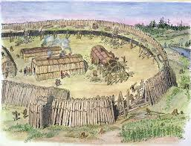
Iroquois Village

Slide 10
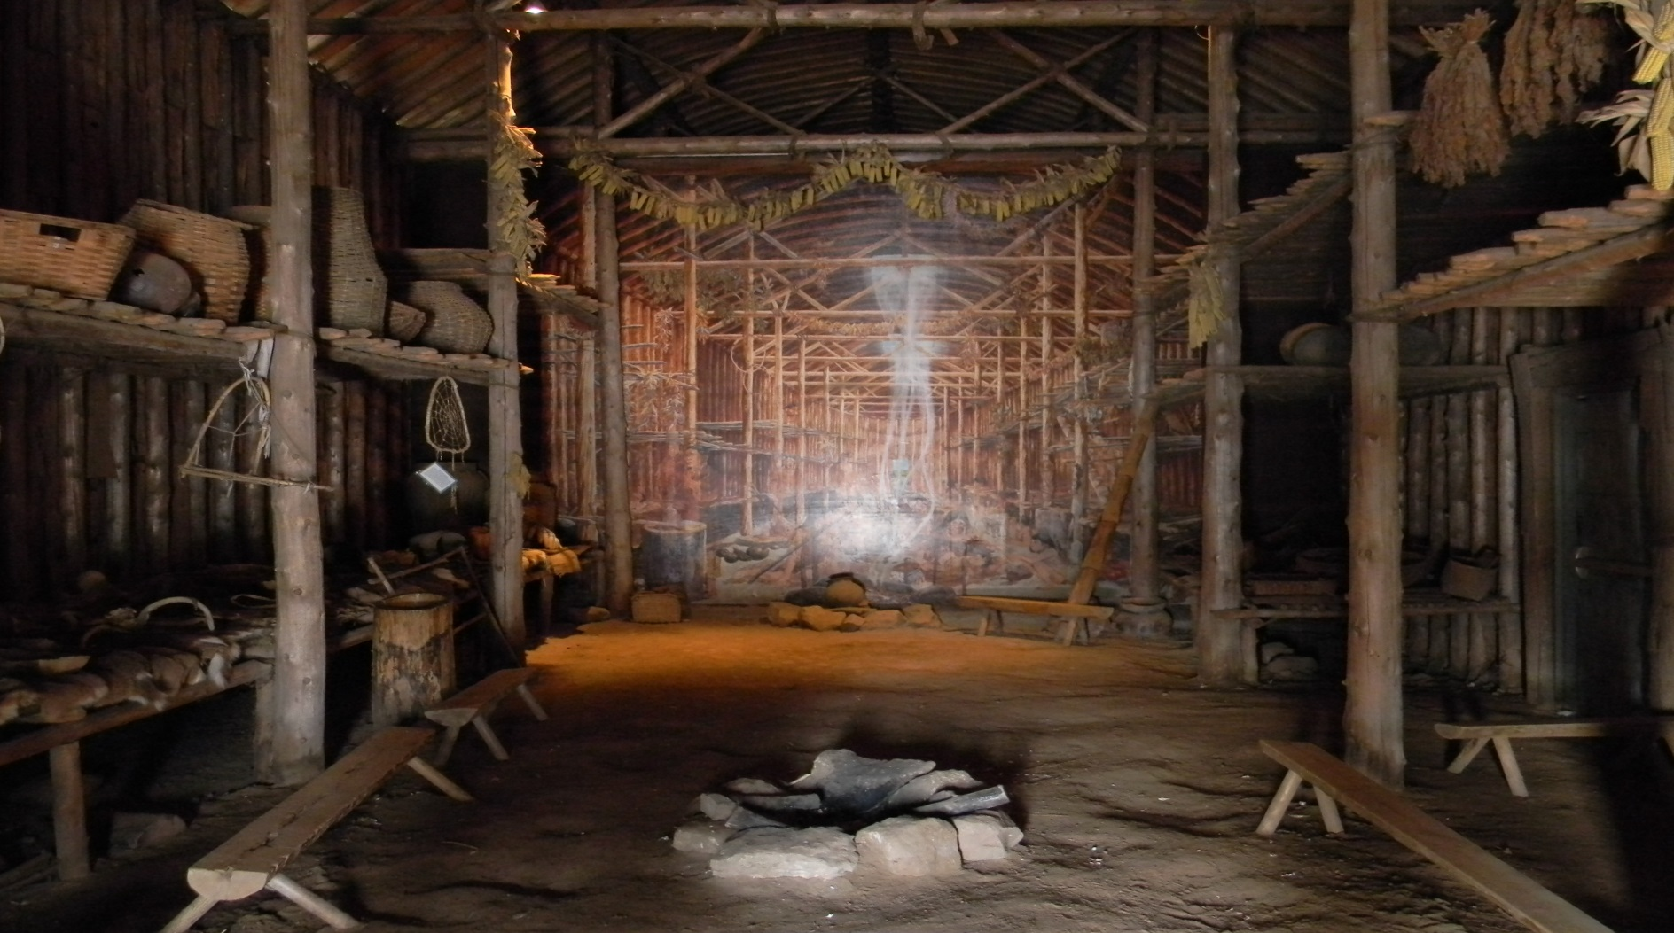
Longhouse

Slide 11
Social/Cultural aspects of the Iroquois nation
Sedentary: lived in one location for 8-10 years
Religion: based on the belief in spirits
Shamans interpreted dreams and healed the sick(Shamanism)
They Believed in animism: The belief that all things have a soul
Believed in coexisting with nature
Oral traditions: Culture was transmitted through stories and songs
Social Life: Danced and played sports in the summer
Men hunted and women grew crops

Slide 12
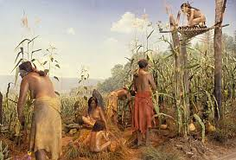
Agriculture

Slide 13
4 Characteristics of the Algonquian
Patriarchy
Algonquian
Wigwams
Nomadic
Shield(Canadian)

Slide 14
The Algonquians
Poor soil and a short growing season in Quebec made agriculture too risky for the Algonquians.
All groups were hunter/gatherers, although their lifestyles differed somewhat due to available resources.

Slide 15
Political Aspects of the Algonquian Nation
Small hunting groups of 3-4 families
Several groups formed a Band which would meet each summer
Each Band had its own territory and was independent
All the bands which spoke the same language considered themselves of the same nation
Society was based upon a Patriarchy

Slide 16
Social Aspects of the Algonquian Nation
Nomadic: followed prey
Religion: based on the belief in spirits
Shamans interpreted dreams and healed the sick(Shamanism)
They Believed in animism: The belief that all things have a soul
Believed in coexisting with nature
Oral traditions: Culture was transmitted through stories and songs
Social Life: Danced and played sports in the summer
Men hunted and women gathered berries, roots and seeds
few possessions
Patriarchy

Slide 17
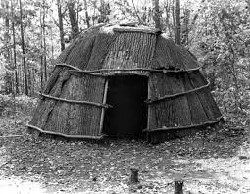
Wigwam

Slide 18
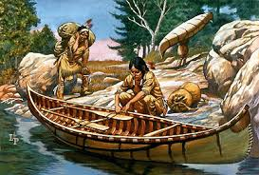
NOMADIC

