Slide 1
Industrialization Phase One:1867-1896 and Phase 2: 1896 - 1929
The march of the machines:

Slide 2
Factors Necessary for Industrialization
Industrialization is the development of industry on a grand scale in a country or region.
For industrialization to take place several factors need to be in place:
Factors Necessary for Industrialization
a large pool of cheap labour (National Policy)
a good transportation system (National Policy)
sources of energy (coal or water power)
investment capital
raw materials
a large internal market protected by tariffs (National Policy)

Slide 3
Agricultural Revolution
In order to support the growing population industrialization transformed the Agricultural sector first
Mechanization of the first sector of the economy freed workers to migrate to the cities and increased the amount of food available to city dwellers
Changes
Farms: 1) Led to diversification of products, 2) in 1870 we see an increase in dairy farms and it soon becomes the leading product
Forestry: 1) Lumber industry grew rapidly due to reciprocity treaty, 2) Emergence of Pulp and paper

Slide 4
Changes in Production
1) Division of labour
Each worker is given a limited job in the production process and allows for mass production
The tasks are limited so it reduces the need for skilled labour in phase 1
2) Production
Focused on local needs in phase 1 as well as railway production
3) Industrial Capitalism
Businessmen use the capital necessary to buy the means of production and use them to make profit
Then they reinvest their profits to buying more machines and factories to increase production
Thus capitalists ensure economic development with aid of the government in terms of infrastructure, favourable laws and lower taxes

Slide 5
Phase 1: 1867-1896
A key aspect of the first phase of industrialization is that it was based on smaller machinery
Other important characteristics are found in the following categories:
Labor: Cheap and unskilled labor, women and children entered the work force
Source of Energy: water and coal
Primary Source of Investment Capital: British and Canadian Business men
Primary Market: Canada and Exports
Regions Industrialized: The Montreal region was the most industrialized however textile plants were also located in Valleyfield and the Eastern Townships (Magog), tobacco was cultivated in Joliette and timber in the Saguenay-Lac Saint-Jean region.

Slide 6
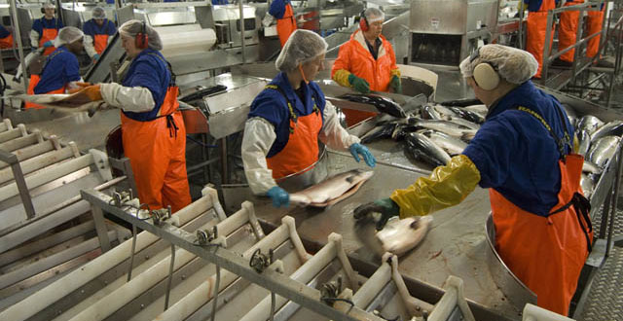
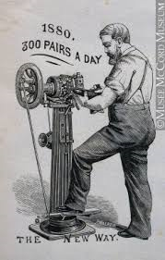
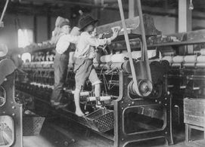
Industries Phase 1: 1867-1896
Food Processing
Shoes and clothing
Leather and textiles

Slide 7
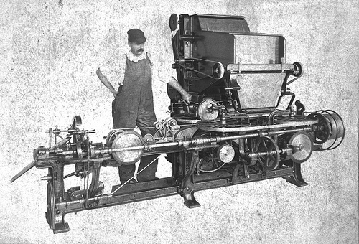
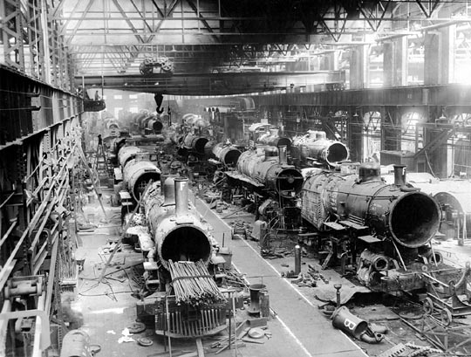
Industries Phase 1: 1867-1896
Tobacco
Transportation

Slide 8
Phase 2:
A key aspect of the second phase of industrialization is that it was based on the exploitation of natural resources
Other important characteristics are found in the following categories:
Labor: Skilled, hard to replace due to training needed led to improvements for workers
Source of Energy: hydroelectricity and gasoline
Primary Source of Investment Capital: USA
Primary Market: Export to USA
Regions Industrialized: Saguenay-Lac Saint-Jean, Trois-Rivieres, Abitibi

Slide 9
Phase 2 industries
Chemical plants
Oil Refineries
News Print/Pulp and Paper

Slide 10
Phase 2 industries
Mining
Hydro Electric Plant
Aluminum Plants

Slide 11
Role of the State Phase 2
In 1897 the Liberals gained power in Quebec and Economic priorities were redefined
For this government the provinces development depended on industrialization, job creation amd exploitation of Natural Resources
Liberals adopted Economic Liberalism: “L’aissez faire economics” based on the freedom of trade, freedom of action for business people and limited government intervention in the economy
Since the state owned all of Quebec’s natural resources they made companies get permits or pay royalties in order to collect natural resources
This increased capital for use by the government

Slide 12
Monopoly Capitalism
Is an economic system where a company can market a product without competition and can assume full control over production of the product(see Mcdonalds)
In the second phase of industrialization companies attempt to maximize their profits in 2 ways
1)Buy out all competitors to create a monopoly on the product so you can control the market
2) Buy all the companies involved in production of your product to lower prices and maximize profits

