Slide 1
Overview: Power and Countervailing Power

Slide 2
Shared Power
Quebec shares power with the Canadian government
Provincial government is under the jurisdiction of the federal government
Distribution of power is covered in the constitution
The Federal Government controls whole country/ while provincial controls the province
This leads to tension between the two since the federal government can say no to provincial laws

Slide 3
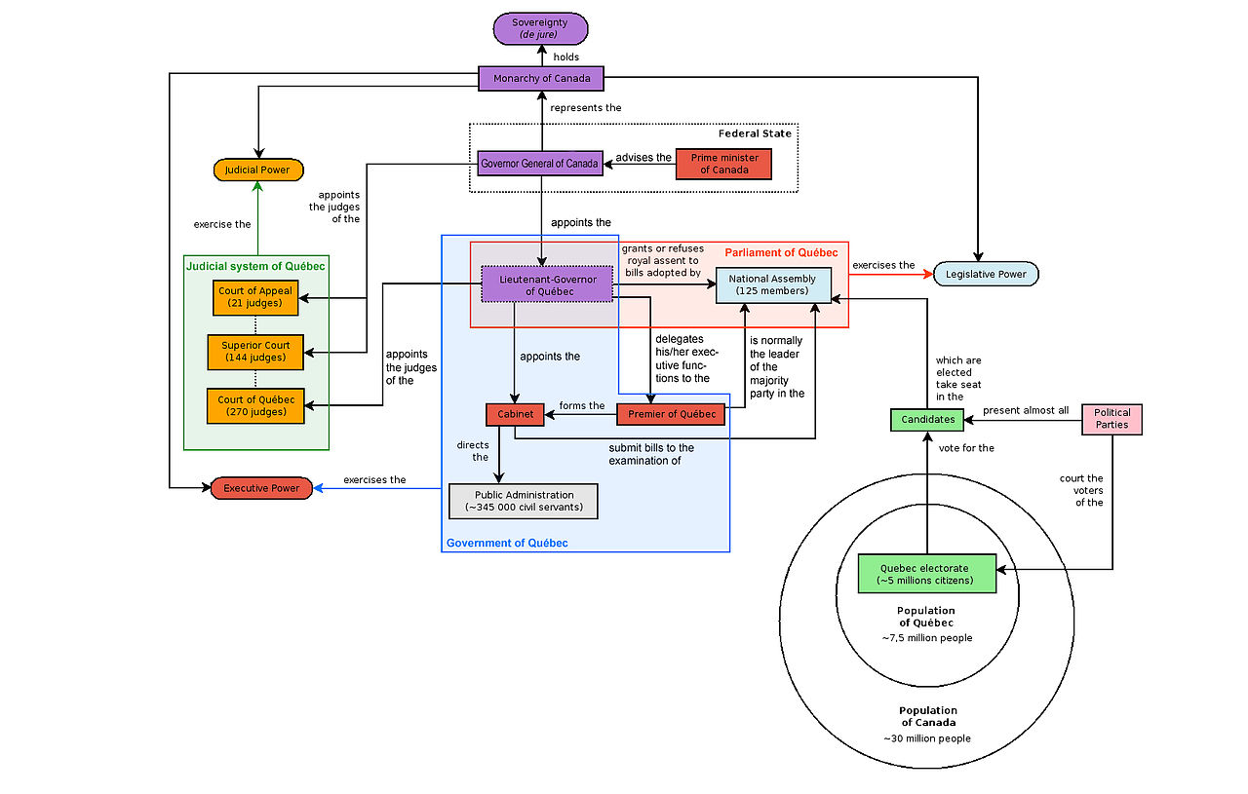
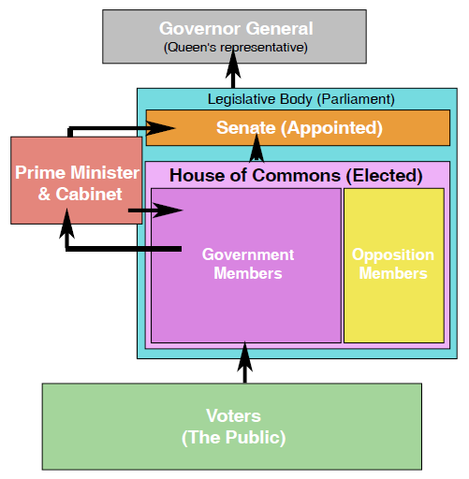
Quebec's Political Power
Quebec is independent within Quebec
The people grant power to the government
There are 3 branches of government power:
Judicial Branch: The ability to punish those who do not follow the rules
Executive Branch: Determines the direction of the government
Legislative Branch: Creates laws

Slide 4
Interest Groups
There are different types of interest groups
1) Media
2) Lobbyists
3) Countervailing Powers

Slide 5
Power of the media
Media is sometimes seen as the fourth branch of power
They can influence public opinion
They can also benefit or harm political parties during elections
Some people wonder if the media has too much power

Slide 6
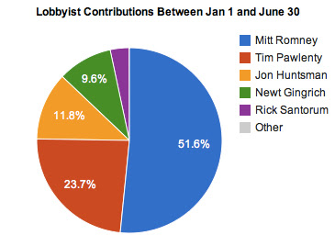
Lobbyists
Lobbyists are people who join forces and work together in order to influence the government
Lobbying is regulated and all lobbyists must be registered
This is done so citizens know who is trying to influence the government

Slide 7
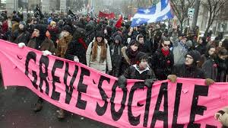
Countervailing Powers
In a democracy citizens have the power to challenge the state
Some interest groups attempt to get the government to act in their interests.
They exert pressure by granting or denying support, or pointing out injustice
Though they do not hold power, they can affect power and its uses
These countervailing forces have created many social programs in the last century

