Slide 1
POPULATION GROWTH IN NEW FRANCE 1608 - 1760

Slide 2
POPULATION GROWTH
Population can increase in two ways, through immigration and natural increase
Immigrants are people who have come in to a country
Natural increase is when births outweigh deaths

Slide 3
Immigration
Between 1608 and 1760 it is believed that 10 000 people immigrated to New France
There were several reasons for the failure to attract new immigrants:
Cold winters
Dangers of Indian attacks
Laws against Protestants
Fur Trade
Long and dangerous trip-to Canada

Slide 4
Who did come?
Engages: People on Contract to come and work...some stayed some did not
Soldiers: Carignan Salieres: Come to protect the French investment in Quebec. Many settled here when their tour of duty was done
Filles de Roi: Orphan girls who were sent to N. France to alleviate the woman shortage. Most of the 770 sent were married within days of arriving

Slide 5
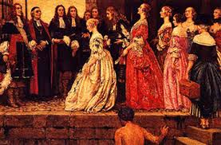
Filles de Roi

Slide 6
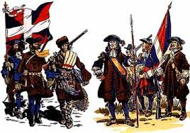
Carignan Salieres

Slide 7
Other Immigrants
Minor Criminals
African Slaves
Captured English children

Slide 8
Natural Increase
Colonies need people to succeed and by 1663 only 3035 people lived in New France
Thus the king decided to take over and appointed Jean Talon as intendant
His job was to increase the size and prosperity of New France
He did this by attempting to attract immigrants (filles de roi) and by helping maintain an atmosphere of Natural increase

Slide 9
Jean Talon
Jean Talon was able to double the population in 10 years
By 1760 the population of New France is 70 000 people, mostly created by natural increase
This large increase was due to government laws and awards that caused people to have large families

Slide 10
Atmosphere of Natural Increase
People were encouraged to marry young
Men over 21 and fathers of daughters over 17 were forced to pay fines
Also these men were not allowed to participate in the fur trade
Men were encouraged to marry Amerindian women
Family allowances were paid out. A family of 10 living, unmarried children were given a year’s salary as a grant
The English also had high natural increase and their population had grown by this time to 1.5 million

