Slide 1
What was the Quebec act(1774)?

Slide 2
Purpose of the Quebec Act
The purpose of the Quebec Act was to appease and conciliate the French Canadians so they would not join the Americans in their revolt against Britain.
The main provisions of the Quebec Act centred around :

Slide 3
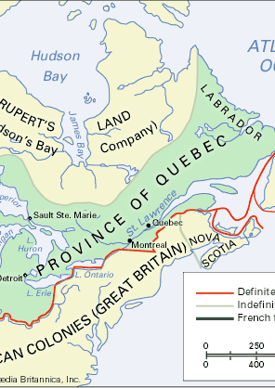
Territory
Quebec's territory was enlarged to include the Ohio Valley.
This was a major change from 1763

Slide 4
Government
Quebec was still to be governed by an appointed governor and council. An elected legislative assembly was again denied.
The Test Act was changed: Catholics could now hold government office by taking a special oath of allegiance to the KING
Roman Catholics could now be appointed to the council. Seigneurs had a chance to take part in government

Slide 5
Religion
Catholics were to have full freedom of worship and the right to collect tithes by the Catholic Church was restored

Slide 6
Legal System
It allowed for French civil law and English criminal law

Slide 7
Seigneurial System
It kept the Seigneurial system but also allowed for freehold tenure which was the British form of landholding.

