Slide 1
Quiet Revolution
1960’s

Slide 2
Quiet Revolution
The Quiet Revolution, also known as La Revolution Tranquille, began in Quebec in 1960 with the electoral defeat of the Union Nationale by Jean Lesage and his Liberal Party
It can be best described as a rapid and far-reaching process of social, economic, and political reform in Quebec from the early to the late 1960s.
Main Features
To make the government of Quebec the major force behind Quebec's social and economic development by greatly increasing the role of the · state in both of these sectors.
To modernize Quebec's educational system and to allow it catch up to the other provinces in Canada
To weaken the influence of the Church and to end Quebec's political isolation.

Slide 3
Government Slogan:
"Maitre chez nous!" - Masters in Our Own House.
Represented the French taking back power in Quebec Society
Lesage modernized the state and enlarged its number of employees

Slide 4
Change in Quebec Nationalism
During this same period the independence movement for Quebec gains momentum.
Quebec nationalists form various political groups advocating sovereignty or independence for Quebec.
The most prominent of these groups was the R.I.N. (Rassemblement pour l'indépendance nationale).
In addition, terrorist organizations, such as the F.L.Q.(Front de Liberation du Quebec) begin to plant bombs targeting military establishments in the Montreal area and mailboxes in Westmount.
The main goal of this organization was to attain independence for Quebec from Canada through the use of violence.

Slide 5
Social Changes under the Quiet Revolution: Education
It set up the Parent Commission which made recommendations to improve the education system.
Education was made compulsory to age 16, cegeps and polyvalentes were built, free textbooks were to be made available until the end of high school.
It established Quebec's first Ministry of Education.

Slide 6
Social Changes under the Quiet Revolution: Health and Social Security
In 1960 it created a hospital insurance plan.
In 1964 the Quebec Pension Plan was introduced.
It created a Ministry of Social Affairs.

Slide 7
Social Changes under the Quiet Revolution: Labor
It adopted a new Labor Code to facilitate unionization and to improve labor relations.
It gave public-sector workers the right to strike.

Slide 8
Government Intervention in the Economy
The government of Quebec felt that the economy should be controlled either through direct or indirect state intervention and action.
This is a form of Economic Nationalism
Indirect state action is when the government creates laws to control a business such as food safety regulations
Direct action was taken by running businesses these were called crown corporations
As a result, throughout the period of the Quiet Revolution, the government of Quebec created a number of government Crown Corporations whose purpose it was to develop Quebec's economy and expertise.

Slide 9
Crown Corporations of the Quiet Revolution
Societe Generale de Financement
SIDBEC
SOQUEM
(SGF) which promotes investment in Quebec companies
attempted to develop the steel industry in Quebec.
Which encouraged the development of mining in Quebec.

Slide 10
Crown Corporations of the Quiet Revolution
Caisse de Depot et du Placement
Hydro Quebec
which manages the government's pension, automobile and workers' compensation funds. Today, it has approximately 60 billion dollars in assets.
Nationalization (government purchase or takeover) of seven of Quebec's largest private hydro-electric companies into Hydro-Quebec six months after the elections of 1962 under the Minister of Natural Resources, Rene Levesque.

Slide 11
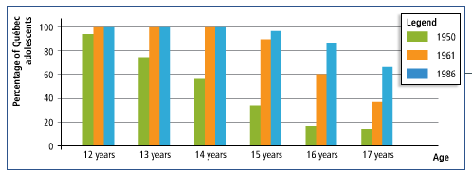
Impact of the Quiet Revolution: Education
The quiet revolution led to a more educated population especially among Francophones
The rise was even larger among women
From 1960-1980 women in University went from 14% to 50.2%

Slide 12
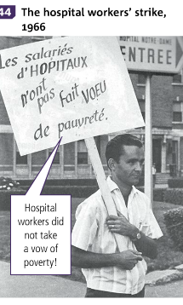
Impact of the Quiet Revolution: Unions
The new labor code caused the rate of unionization to skyrocket in the early 60’s

Slide 13
Impact of the Quiet Revolution: Francophones and the World
State intervention and leadership in economic development promoted to creation of French led businesses
This formed a new Francophone elite
Quebec also became more open to the world and other cultures
This can be seen in increased travel and hosting expo 67

Slide 14
Relations Between Quebec and Ottawa
The sovereigntist/nationalism movement in Quebec began to worry Canada
In 1963 Pearson creates the Royal commission on Bilingualism and Biculturalism known as the Laurendeau-Dunton Comission
It was to study the state of bilingualism and show the federal governments openness to Quebec’s demands
It made 2 observations
1) Francophones did not have access to federal civil service as these positions were held by Anglophones
2) francophone minorities were less privileged than Anglos
This led to the passing of the Official Language Act of 1969 making French and English the official languages of Canada

