Slide 1
What were the main stages in the Rebellions of 1837-1838 ?

Slide 2
Social Issues
Throughout the 1830's the social and economic conditions grew worse in Lower Canada. There were:
food shortages due to poor harvests and drastic drops in wheat production
thousands of newly arrived British immigrants
cholera epidemics

Slide 3
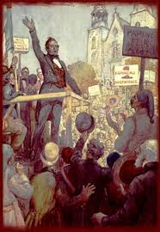
Protests
There were 2 rebellions one in lower Canada and one in Upper Canada
People were afraid and upset and wanted the government to change

Slide 4
Demand for Change
In 1834, Papineau, leader of the Patriotes, issued the 92 Resolutions, a list of Patriotes' grievances and demands.
Three major political demands were:
1) responsible government
2) control of public spending by the assembly
3) an elected legislative council

Slide 5
Rebellion
In 1837, Lord John Russell responded with the 10 Resolutions which rejected Papineau's key demands.
In the fall of 1837, demonstrations organized by the Patriotes gradually lead to political unrest and open rebellion

Slide 6
Armed conflict
A first armed conflict occurred in 1837 when the 26 members of the Patriote movement, who had been charged with illegal activities, chose to resist their arrest by the authorities under the direction of John Colborne.
Papineau escaped to the United States, and other rebels organized in the countryside.
they defeated a British force at Saint-Denis on November 23, 1837. The British troops soon beat back the rebels, defeating them at Saint-Charles on November 25 and at Saint-Eustache on December 14.
The troops pillaged and ransacked Saint-Eustache. On December 5, the government declared martial law in Montreal.
Taken from https://en.wikipedia.org/wiki/Lower_Canada_Rebellion

Slide 7
Results
By the fall of 1838, the Patriotes were defeated and the rebellion had failed.
Several men were exiled to Australia and 12 were hanged.
Lord Durham was sent by the British government to investigate the causes of the rebellions and to propose solutions to the political problems in Upper and Lower Canada.

Slide 8
What was the Durham Report?
Lord Durham was sent to the Canadas in 1838 to investigate the causes of the rebellions and to find solutions to the political problems plaguing Upper and Lower Canada.
In February 1839, in a report made to the British parliament, Lord Durham infuriated the French when he referred to them as inferior to the English and "as a people with no history and no literature".
In the report he explained that he expected to find a conflict between a government and a people, but instead found two nations at war within the same state.
It was a war based on race, not on principles. In his opinion, Canada was a land of two hostile groups: the French and the English.

Slide 9
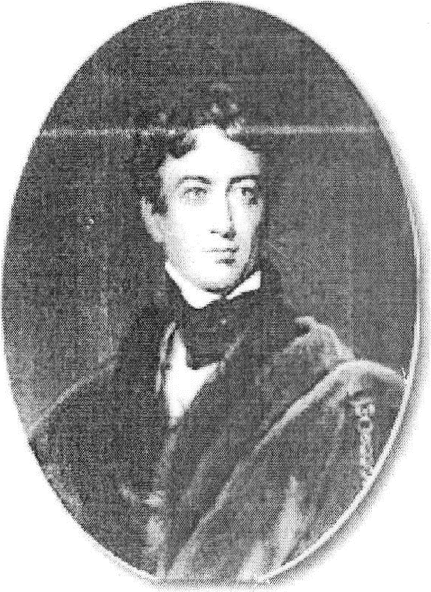
Durham’s Recommendations
1) to unite Upper and Lower Canada to make the French a minority
2) to assimilate or anglicize the French majority in Lower Canada
3) to grant responsible government

Slide 10
Consequences of the Durham report
Upper and Lower Canada were united in 1840
Attempted to Assimilate the Canadiens
Responsible government was granted in 1848 due to cooperation of the moderates in the Legislative assembly.

