Slide 1
Royal Government

Slide 2
Settlement Colony
Between 1608 and 1663 companies were in charge of the colonies of New France
The King displeased with the company’s progress, took direct control of the colonies by placing it under control of his minister of the marine
He could do this because he was an absolute monarch, his word was law and he could name and dismiss officials when he wished
This is known as absolutism

Slide 3
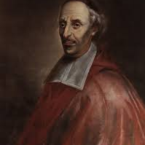
BISHop
Assigned by the Pope
Supervised clergy
Ran the churches and schools
Also ran charitable works

Slide 4
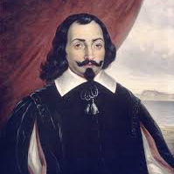
The Intendant
Assigned by the king
Head Administrator
Second in rank but most influential due to control of government finance
Responsible for judicial system
Responsible for infrastructure and trade
Also had power over seigneuries

Slide 5
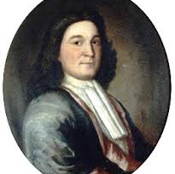
Governor
Assigned by king
Highest ranking official of New France.
He is responsible for the military, relations with English and Amerindians and defending the colony

Slide 6
Mnemonic
B ishop S ocial
I ntendant E conomic
G overnor P olitical
These three men together with some few (rich) citizens made up the Sovereign Council
Ordinary people had no say in the government they were expected to follow orders as this is not a democratic system

Slide 7
The Intendants
As we have seen through Jean Talon’s efforts to increase the population of New France, the intendant was very influential in the life of the colony
Not only did they address the population difficulties but they also attempted to fix the economic difficulties of the settlement
The two most important intendants were Jean Talon and Gilles Hocquart
They made important changes which changed the colonies in New France from commercial ventures to settlements for social purposes

Slide 8
Jean Talon
Changes in Farming:
1) Granted more seigneuries
2) Brought more immigrants
3) Increased farm animals
4) Encouraged economic crops
Changes in Industry:
1) Encouraged trade with France
2) Hat Making
3) Ship Building
4) Tanning
*Talon also encouraged the triangular trade

Slide 9
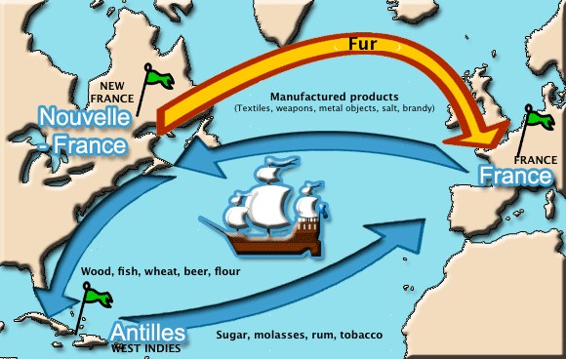
Triangular Trade: Trying to Diversify the Economy

Slide 10
Gilles Hocquart
Changes in Farming:
1)Opened more seigneuries on other rivers
2) Increased cultivated lands to 3X previous amounts
3) Exporting surplus wheat
Changes in Industry:
1) Improved shipbuilding
2) Created an iron foundry near Trois Rivières
3) Hat making
4) Tar making
Also increased fishing vessels from 400 to 8000

Slide 11
Results for the Economy
Unfortunately these undertakings never truly strengthened the French colonies
They were continually dependent on France for goods
This is due to the belief in Mercantilism

