Slide 1
What was the Royal Proclamation (October 1763)?

Slide 2
Purpose of the Royal Proclamation
to deal with the problems of language, religion, and the legal and Seigneurial system in the newly conquered colony
to replace the military government in the colony with a civil administration
to pacify the western Indian tribes (Pontiac's rebellion).
To Assimilate the French

Slide 3
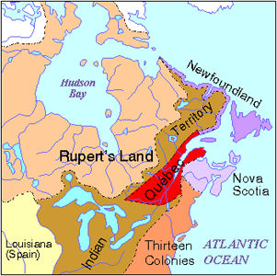
Territory
The new colony was now called the Province of Quebec however its territory was reduced to a triangular shape along the St. Lawrence River.
The Ohio Valley was denied to both Quebec and the British-American colonies. It was reserved for the Native Indians.

Slide 4
Government
The British military government was replaced by a civil government consisting of an appointed Governor (Governor Murray) and an appointed executive council that was sympathetic to the French Canadians
Murray refused to create a legislative assembly as it would give power to 1 percent of the population and cause friction in the colony

Slide 5
Religion
Freedom of worship was continued however instructions to Murray indicated Britain 's intention of establishing a Protestant church and schools as a means of assimilating the French.
Roman Catholics were not permitted to hold public office since the Test Act required office holders to take communion in the Church of England.
An elected legislative assembly was promised when conditions would be more appropriate.

Slide 6
Legal System
It intended to replace the French Civil Code with British Common Law however Governor Murray found this to be impractical. Instead, he created two courts of law:
a Superior Court would deal with more serious cases and apply the laws of England
a lesser court would hear minor cases and apply the old French laws.

