Slide 1
Techniques and Elelments 5

Slide 2
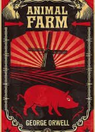
Allegory
Is a story that is used to represent historical events or issues within society
It is used to explore issues from a different point of view
The novel Animal Farm is an allegory of the Russian Revolution

Slide 3
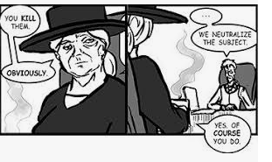
Euphemism
A euphemism is when a more mild or indirect word or expression is used in place of another word or phrase that is considered harsh, blunt, vulgar, or unpleasant.
When we say some one is height challenged instead of short, this is an euphemism
Used to show character

Slide 4
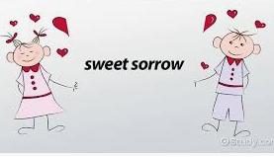
Oxymoron
An oxymoron is a combination of two words that, together, express a contradictory meaning.
Jumbo Shrimp is an example
This device is often used for emphasis, for humor, to create tension, or to illustrate a paradox

Slide 5
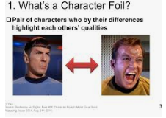
Foil
In literature, a foil is a character that has characteristics that oppose another character, usually the protagonist
The foil character is used to highlight some particular quality or qualities of the main character.
A subplot can also work as a foil to the main plot.

Slide 6
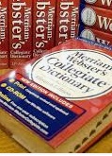
Diction
Diction can be defined as the style of speaking or writing, determined by the choice of words by a speaker or a writer.
Types of Diction
Individuals vary their diction depending on different contexts and settings.
Formal diction – formal words are used in formal situations, such as press conferences and presentations.
Informal diction – uses informal words and conversation, such as writing or talking to friends.
Colloquial diction – uses words common in everyday speech, which may be different in different regions or communities.

