Slide 1
Techniques and Elements 4

Slide 2
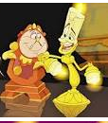
Anthropomorphism
the attribution of human characteristics or behavior to a god, animal, or object
Unlike personification the object is a fully formed character like Bugs Bunny or Lumiere

Slide 3
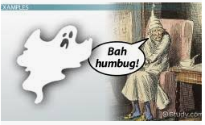
Flashback
When a scene happens earlier than the beginning of the story
Can be used to forward exposition, theme, character development and several other ways

Slide 4
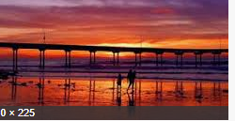
Imagery
Vivid pictures created for any of the five senses: sound, sight, taste, feel and smell
Imagery shows the reader the story instead of telling them making it real to the reader

Slide 5
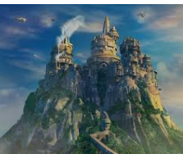
Setting
Setting is both the time and geographic location of the story
This element initiates the backdrop and mood of the story
It adds to the meaning often through allusion to the prior knowledge of the reader

Slide 6
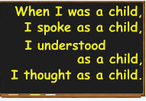
Repitition
Repetition is a literary device that repeats the same words or phrases a few times to make an idea clearer and more memorable.
As a rhetorical device, it could be a word, a phrase, or a full sentence, or a poetical line repeated to emphasize its significance in the entire text.

