Slide 1
Techniques and elements
Shakespeare Edition

Slide 2
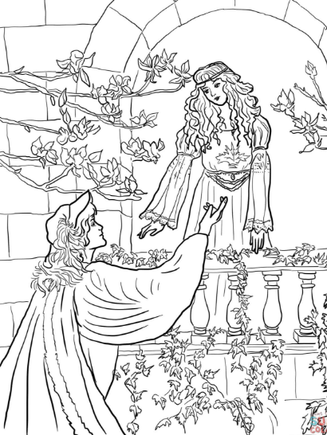
Soliloquy
Speech given by a character in order to show that character’s thoughts
It is not a monologue as a monologue is given to the audience while a soliloquy is given to one’s self
In Act II, scene ii, from line 2 to 26, Romeo expresses his thoughts about Juliet when he sees her appear on the balcony in a soliloquy

Slide 3
Aside https://literarydevices.net/aside/
An aside is a short comment or speech that a character delivers directly to the audience, or to himself, while other actors on the stage appear not to hear.
The difference between them is that an aside is a shorter comment, while a soliloquy is a longer speech.
Another difference is that an aside reveals hidden secrets or judgments, whereas the soliloquy reveals motives, inner thoughts, or internal struggles going on in the mind of the character.

Slide 4
Rhyming Couplet: https://www.oxford-royale.co.uk/articles/literary-terms-english.html
A rhyming couplet is two lines of poetry with the words at the end of each rhyming.
a rhyming couplet summarizes a particular thought, but entire works can be written in rhyming couplets,
Poets often choose the rhyming words very carefully, so that even these two words encapsulate an idea.

Slide 5
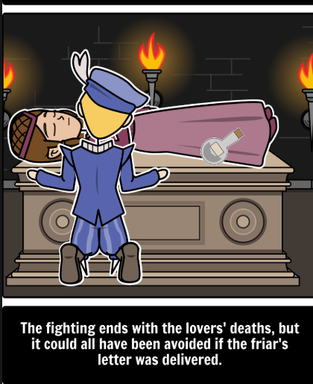
Tragic Hero https://literarydevices.net/tragic-hero/
When a hero confronts downfall, he is recognized as a tragic hero or protagonist
The tragic flaw of the hero leads to his demise or downfall that in turn brings tragic end. This gives wisdom to the audience to avoid such things in their everyday lives
Romeo's tragic flaw is his impetuosity, his rashness of action before thinking thoroughly.

Slide 6
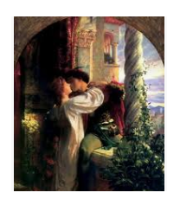
Recurring Imagery https://penandthepad.com/dramatic-techniques-shakespeare-8540495.html
Visual cues, such as recurring images and symbols, foreshadow events and help viewers connect ideas and themes throughout the story.
This dramatic technique helps the audience see, not just hear, important details about the play.
For example, Shakespeare repeatedly contrasts light and darkness in "Romeo and Juliet," foreshadowing the eventual demise of forbidden love.

