Slide 1
Techniques and elements of Literature
Definition page 1

Slide 2
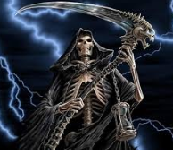
Personification: helps reader visualize and add meaning
Definition 1) is when you give human qualities or abilities to an object or animal.
Oreo: Milk's favorite cookie - Oreo
Definition 2) representing and idea in human form

Slide 3
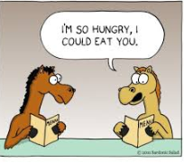
Hyperbole
Exaggeration or overstatement usually used to add humor

Slide 4
Symbolism
In literature, symbolism can take many forms including:
A figure of speech where an object, person, or situation has another meaning other than its literal meaning.
The actions of a character, word, action, or event that have a deeper meaning in the context of the whole story

Slide 5
Foreshadow
Foreshadowing in fiction creates suspense in a story, so that the readers are interested to know more.
Foreshadowing is when the author hints at future events.

Slide 6
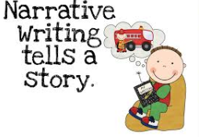
Narrative
Is the telling of a story

