Slide 1
Techniques and elements of Literature
Page 2

Slide 2
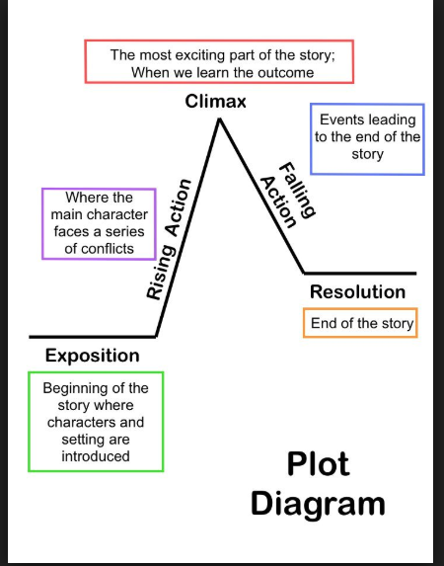
Plot
Main events in a piece of fiction presented in a sequence to convey a message

Slide 3
Exposition
used to introduce background information about events, settings, characters, or other elements of a work to the audience or readers.
Without exposition nothing would make sense
https://www.youtube.com/watch?v=elfuc4j6ozg

Slide 4
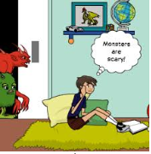
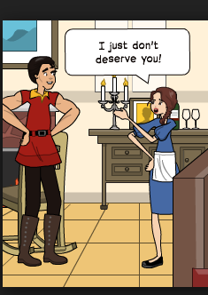
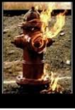
Irony
Dramatic
Verbal
Situational
When the reader has information that the character in the story does not.
When the meaning of the words are opposite to what the speaker really means or feels
When a situation turns out differently than what is normally expected

Slide 5
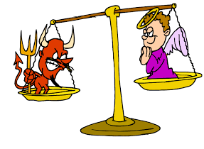
Conflict
Internal Conflict: When the main obstacle of the story comes from within the protagonist
External conflict: When the obstacle overcome by the protagonist comes from outside the character:
Man vs. Man, Man vs. Nature,
Man vs. Society, and Man vs. Technology.

Slide 6
Theme
The main idea of the story which must be stated in a complete sentence
A story may have several themes.

