Slide 1
Techniques and elements of Literature
Page 3: Poetry

Slide 2
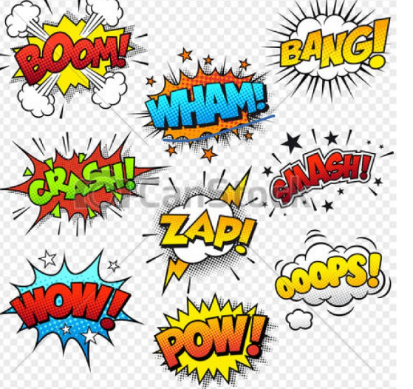
Onomatopoeia
Used to grab peoples attention or add atmosphere to a piece
Definition: when a word represents a sound

Slide 3
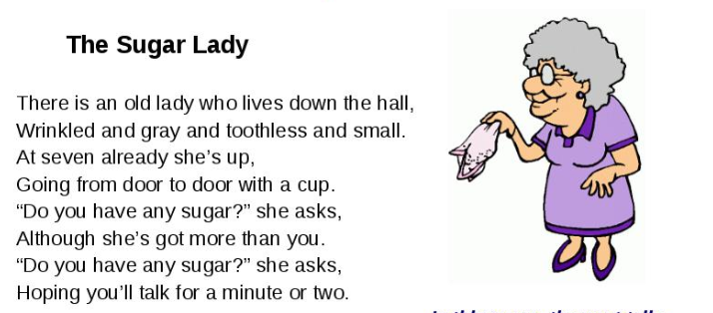
Speaker
The person telling the story…not the author but the narrator of a poem
Conveys the ideas of the writer much like an actor or protagonist

Slide 4
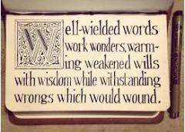
Alliteration
is the repetition of initial consonant sound
Its purpose is to focus your attention to a particular text or to create tone

Slide 5
METAPHOR
When a word or action is connected to a word phrase it is not usually connected to in order to create a comparison
It is connected to imagery

Slide 6
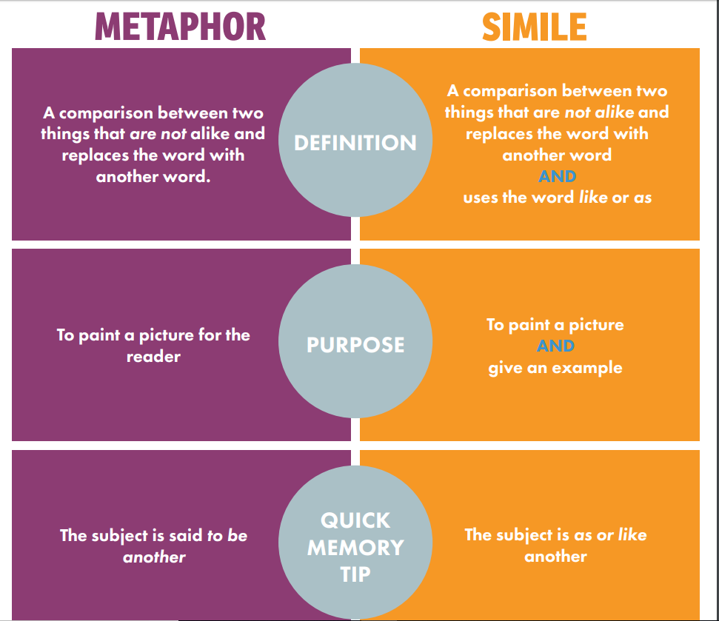
Simile
A comparison using like or as
Connected to imagery

