Slide 1
Techniques and Elements of Poetry

Slide 2
Rhythm: https://www.youngwriters.co.uk/terms-rhythm
Rhythm is the pattern of stresses within a line of verse. All spoken word has a rhythm formed by stressed and unstressed syllables. When you write words in a sentence you will notice patterns forming.
In poetry pre measured patterns of stressed and unstressed syllables are called meters
Stressed syllables - long sounding
Unstressed syllables - short sounding
Meters are the pattern of feet within a sentence
Feet are individual units of rhythm made up of patterns of syllables.
A sentence is made up of one or more feet.

Slide 3
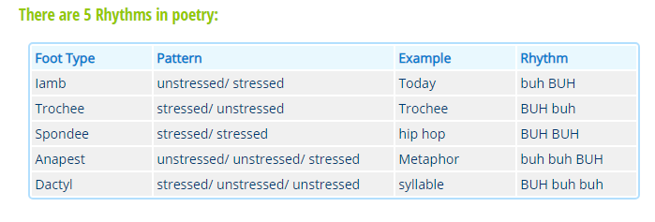
Rhythm Continued

Slide 4
Speaker https://penandthepad.com/tell-speaker-poem-4681.html
The speaker is the voice or "persona" of a poem.
One should not assume that the poet is the speaker, because the poet may be writing from a perspective entirely different from his own, even with the voice of another gender, race or species, or even of a material object
The reader or listener must do more than just hear the voice of the poem to identify the speaker. It is important to examine the other elements of the poem

Slide 5
Rhyme http://www.literarydevices.com/rhyme/
Rhyme is a popular literary device in which the repetition of the same or similar sounds occurs in two or more words, usually at the end of lines in poems or songs.
There are many different ways to classify rhyme. Many people recognize “perfect rhymes” as the only real type of rhyme.
For example, “mind” and “kind” are perfect rhymes, whereas “mind” and “line” are an imperfect match in sounds.
Even within the classification of “perfect” rhymes, there are a few different types:
Single: This is a rhyme in which the stress is on the final syllable of the words (“mind” and “behind”).
Double: This perfect rhyme has the stress on the penultimate, or second-to-last, syllable (“toasting” and “roasting”).
Dactylic: This rhyme, relatively uncommon in English, has the stress on the antepenultimate, or third-from-last, syllable (“terrible” and “wearable”).

Slide 6
Assonance https://examples.yourdictionary.com/assonance-examples.html
Assonance is the repetition of vowel sounds in nearby words. It is used to reinforce the meanings of words or to set the mood.
In this example by Carl Sandburg, in Early Moon, the long "o" sounds old or mysterious.
"Poetry is old, ancient, goes back far. It is among the oldest of living things. So old it is that no man knows how and why the first poems came."
Assonance examples are sometimes hard to find, because they work subconsciously sometimes, and are subtle.
The long vowel sounds will slow down the energy and make the mood more somber, while high sounds can increase the energy level of the piece.

Slide 7
Stanza
In poetry, a stanza is a division of four or more lines having a fixed length, meter, or rhyming scheme.
Stanzas in poetry are similar to paragraphs in prose. Both stanzas and paragraphs include connected thoughts, and are set off by a space.
The number of lines varies in different kinds of stanzas, but it is uncommon for a stanza to have more than twelve lines.
The pattern of a stanza is determined by the number of feet in each line, and by its metrical or rhyming scheme.

