Slide 1
The 1970’s

Slide 2
Vocabulary
Labor confederation: an organization that brings together several unions
Patriate: To transfer control of a constitution from a mother country to its former colony
Amending formula: procedure to be followed in order to amend or change a constitution

Slide 3
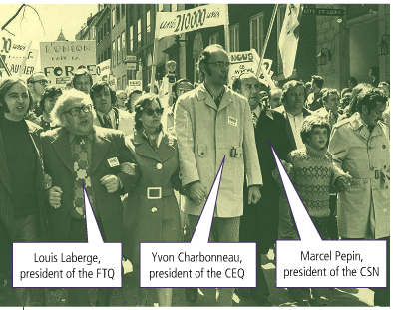
What were the principal sociocultural developments in Quebec during this period? 1970-1976
Premier: Robert Bourassa
Implemented health insurance or Medicare
Created community health services or CLSCs
Legislated the Quebec Charter of Human Rights and Freedoms
Dealt with the Common Front Strikes of 1972 involving the public and para public sector workers associated with Quebec's three largest labour federations i.e. the CEQ, FTQ (Quebec Federation of Labour) and CSN (Confederation of National Trade Unions)

Slide 4
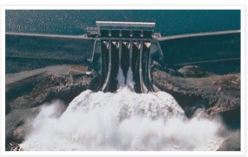
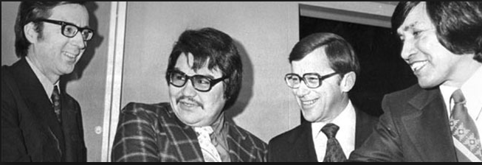
Economic Changes: 1970-1976
Premier: Robert Bourassa
1973-oil crisis hits industrialized countries hard and ends historic 30 years of economic growth since WWII
The key economic development during this entire period was the construction of the James Bay hydroelectric project.
However, the Quebec government was forced to negotiate with the Cree and Inuit peoples since they opposed the construction of dams in James Bay.
In 1975, the Quebec government signed the James Bay Agreement with the Cree and Inuit allowing the project to continue.
This is the beginning of aboriginalism in Quebec which is the recognition of the rights of aboriginal races.

Slide 5
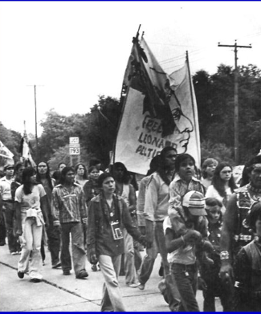
Indigenous Self Determination
In the early 70’s there is a growing movement for self determination among aboriginal groups
To address their claims they created new organizations such as the Native Council of Canada in 1970 and the Native Alliance of Quebec in 1972
Aboriginals also turned to the courts for the first time. The Nisga’a of B.C, in 1973, asked the supreme court to make a judgment on their Ancestral Rights
Though they lost their case it did prompt the federal government to develop a policy on how to deal with the claims of aboriginal groups and negotiate agreements
In 1974 Ottawa set up the Office of Native Claims to more effectively manage Amerindian claims

Slide 6
October Crisis/
https://www.youtube.com/watch?v=XfUq9b1XTa0
https://www.youtube.com/watch?v=RxhbzCRLVVo

Slide 7
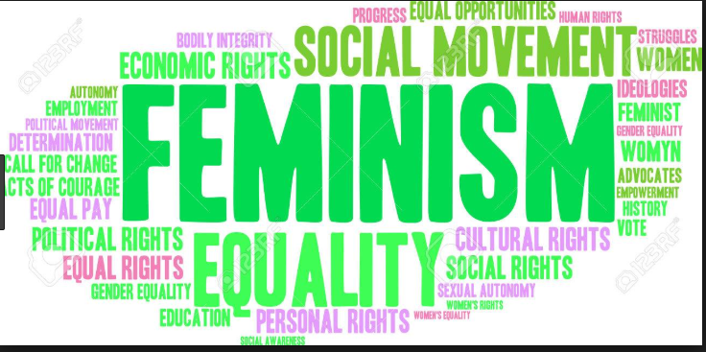
Feminist Demands
1970 the Federal government published the Report of the Royal commission on the Status of Women in Canada also known as the “Bird Report” after its chainman Florence Bird
It stated that even though women had equal rights hey were still subjected to many injustices
Their main demands were pay equity, abortion, maternity leave, and the establishment of child care services
Many women worked for these goals through organizations and the arts.
Many films and books were written to further these demands

Slide 8
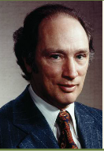
Relations between Quebec and Ottawa
Pierre Elliot Trudeau wanted to patriate the Canadian constitution
he also wanted to revise the division of powers between the federal an provincial governments and create an amending formula
But before this could happen the Provinces had to agree to the new deal
So the federal government and the 10 premieres met in BC 1971 to discuss this in Victoria BC
Quebec worried they would lose rights and autonomy under the new rules so they refused the new deal, and the conference failed

Slide 9
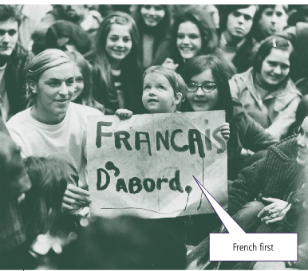
Quebec’s rising identity (provincial question in the past)
Quebecers were worried that French was losing ground because many Immigrants were choosing English Schools
They saw the need to reinforce the French Charter and raise awareness among immigrants
In 1974 Bourassa’s government passed the Official language Act also known as bill 22
This act made French the Provinces only official language and limited access to English schooling to Only children who could prove a good working knowledge of English

Slide 10
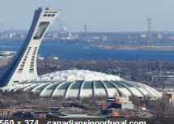
Other events of Note
Montreal Olympics 1976
Quebec gets a higher international profile
Political opposition
The Parti Quebecois was founded in 1968 by under Jean Lesage, whose Mouvement Souverainete-association joined forces with other political groups, espousing the independence of Quebec, to create the Parti Quebecois.
The newly created Parti Quebecois got 24% of the popular vote in the elections of 1970, 30% in 1973, and it came to power in 1976.

Slide 11
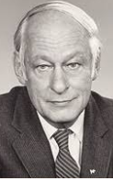
What were the principal sociocultural developments in Quebec during this period? 1976-1980
Premier: Rene Levesque
Maternity leave and increased access to daycare
Agricultural zoning laws were passed so as to better protect Quebec's farmland
Adoption of anti-scab laws which prevented companies from hiring strike breakers (scabs) during labor conflicts
Liberalization of access to abortion for women

Slide 12
Economic Changes: 1970-1976
Premier: Rene Levesque
Continued state intervention in Quebec's economy (creation of the Quebec automobile insurance plan) - a plan whereby the State would compensate victims of car accidents for loss of life or injuries sustained.
The 1970s also saw the emergence of a Francophone Quebecois business class and the rise to prominence of companies such as Jean Coutu, Bombardier, Hydro-Quebec, Quebecor, and Cascades.

Slide 13
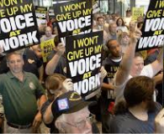
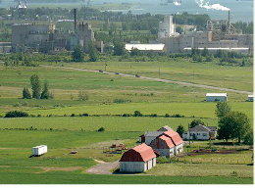
Political and other Reforms
Labor relations: Unions were difficult for Bourassa but supported Lévesque so the government was sensitive to their demands
In 1977 they created the Rans Formula that forced owners to collect union dues from employees and give it to the unions
In 1979 the PQ also created The act respecting labor standards giving protection to non unionized workers
IN 1978 the Act Respecting farmland was created to protect farmland in Quebec that was being threatened by the expansion of Urban agglomeration
In 1977 The act to Govern the Financing of Political parties was passed
1) State assumed responsibility for the majority of expenses
2) Only voters could give money, companies and lobby groups could not
3) Maximum 3000$ per citizen
4) Anyone who paid more than 100 was published and made public

Slide 14
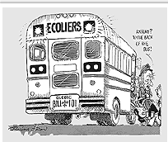
Language Debate: Bill 101
French the only official language in Quebec
Imposes unilingualism in the legislature, signs, work. commerce and stated that all immigrants must go to French schools.
The only children who could go to English schools were those whose parents received an education in English in Quebec.
Replaced Bill 22
Many English feel they have no place and leave, English population dropped by 90 000 people

Slide 15
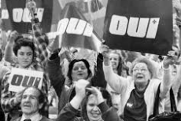
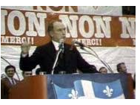
Language Debate: 1980 Referendum
During the elections of 1976, Levesque promised that he would hold a referendum on sovereignty-association.
A referendum is a general vote by the electorate on a single political question that has been referred to them for a direct decision.
On May 20, 1980 the electorate of Quebec was asked the following question:
The Government of" Quebec has made public it’s proposal to negotiate a new agreement with the rest of Canada, based on the equality of nations: this agreement would enable Québec to acquire exclusive power to make its own laws, levy its taxes and establish relations abroad - - in other words –sovereignty – and at the same time, to maintain within Canada an economic association including common currency; no change in political status resulting from these negotiations will be effected without the approval by the people through another referendum; on these terms. Do you give the Government of Québec the mandate to negotiate the proposed agreement between Québec and Canada? YES_____ NO___

Slide 16
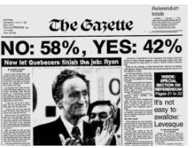
Results
The Yes forces were led by Rene Levesque and the No forces were led by Liberal leader, Claude Ryan.
On Referendum night, Levesque's referendum on sovereignty-association was soundly defeated
60% of the electorate voted against sovereignty-association
40% voted in favor of negotiating sovereignty-association

Slide 17
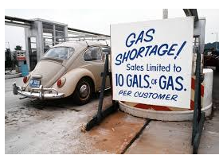
Economic Downturn
End of the 70’s was marked by an economic downturn
A second oil crisis led to a new wave of inflation while labor costs made many companies move jobs out of Quebec
The rise of Unemployment led to slow economic growth and led to tax losses for the government
To maintain services taxes needed to be raised
Governments went into major debt
Some experts believed we need to get away from Interventionism and reduce services
This is hotly debated through out the 80’s and 90’s

