Slide 1
THE 60’s
The changing times

Slide 2
Definitions
Welfare State: State that interferes socially and economically in the lives of citizens to make their lives better
Urban Agglomeration: locality comprising a large city and its suburbs
Counterculture: Fringe cultural movement that counters the dominant culture
Universal Suffrage: when the right to vote is given to all people of voting age
Self-Determination: right of a people to decide what best suits their needs
Labor confederation: An organization that brings together several unions
White Paper: a document that presents government proposals to instigate debate

Slide 3
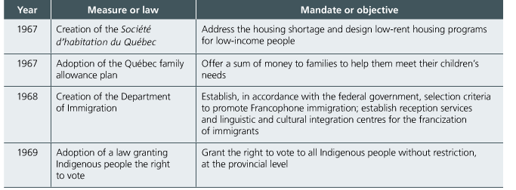
Union Nationale in Power 1966-1970
Daniel Johnson and the Union Nationale were elected in 1966-1970
He continued the Quiet revolution and turned his back on Duplessis’s social conservatism

Slide 4
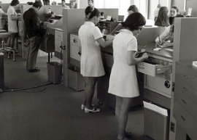
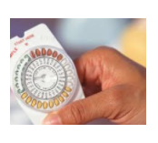
Demographic Changes: Birth Rate
DURING THE 1960’S THERE WAS A MAJOR DROP IN QUEBEC’S BIRTH RATE
Several factors account for this:
1) Women were working more so they could not care for large families
2) The birth control pill become commonly used allowing women to chose when they became pregnant
3) Changing attitudes did not place an importance on a large family

Slide 5
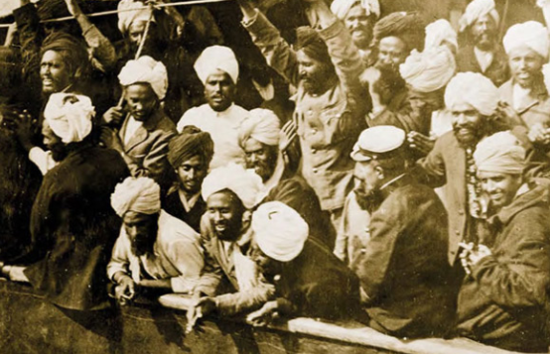
Demographic Changes: Immigration
In the 60’s the government gradually changed its immigration policies
It revoked limitations on non-western countries
In 1967 it introduced immigration laws based on a candidates training and needs of the economy
Most immigrants were still westerners but we see immigrants from the west Indies, India, Pakistan and other developing nations
Montreal and Quebec become more multicultural

Slide 6
Expansion of Consumer Society
The consumption of goods becomes increasingly important
Factors explaining this:
1) Wages increase faster than prices giving Quebecers more purchasing power
2) Many goods became more affordable
3) Development of a leisure society developed products that were used to consume free time
4) Advertising propelled purchasing decisions

Slide 7
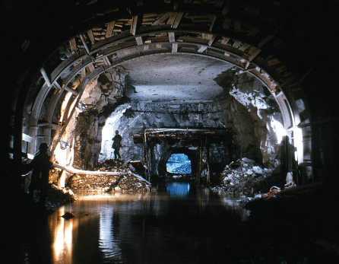
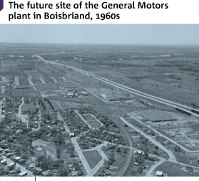
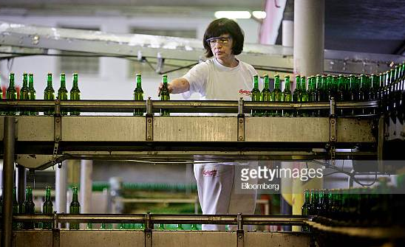
AREAS AND CHANGES IN Economic Growth
Public investment: Government invested large amounts in infrastructure, (metro systems and schools, etc)
Investment in large projects like bridges and high ways stimulated economic growth
Modernization of factories led to 3 important developments
1) Production became increasingly automated leading to job losses
2) Cost of modernization was so high production became centered In large companies
3) Many companies relocated abandoning Quebec for Ontario or old neighborhoods to industrial parks

Slide 8
Urban Agglomerations
Urban agglomerations developed as a result of 4 phenomenon
1) American influence that presented that living in suburbs was a model of social success
2) Infrastructure development allowed fast and easy transportation to the suburbs
3) NEW factories in the suburbs made people move there
4) The middle class found the suburbs to be comfortable offering a quality of life only available to the rich before this time, such s large back yards on tranquil streets
This created urban sprawl

Slide 9
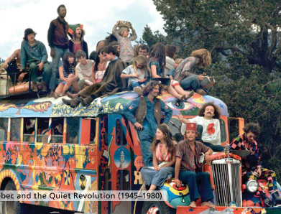
Changing Attitudes: Challenging traditional Values
In the 60’s traditional values were being challenged more than ever
Fewer people than ever attended church and the number of priests and religious communities was also dropping
In 61 61% of people attended church by 71 it was down to 30%
Marriages also decreased as more and more Quebecers were living in common law relationships
Divorce increased due to a federal law making it easier to obtain a divorce

Slide 10
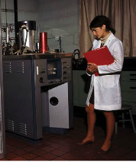
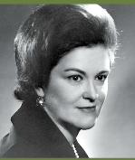
Women's Rights
Women's Equality continued to be a major social issue in the 60’s
Abortion rights and Legal rights topped the list of feminist demands
In 64 Marie Claire Kirkland-Casgrain was responsible for the Acting respecting the legal Capacity of Women allowing women to sign contracts and other transactions without their husbands consent
In 1966 the FFQ(Federation des femmes du Quebec) was founded
By 1969 the FFQ had advocated for abortion rights, Abortion became permitted in certain cases with the approval of a 3 doctor committee before this it was a criminal offense

Slide 11
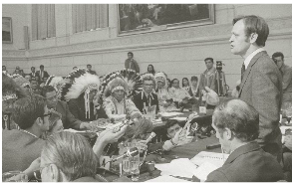
Indigenous Nations
The 60’s see a beginning of greater mobilization among indigenous people
1969 The federal government creates a white paper entitled “Statement of the Government of Canada on Indian Policy 1969”
In the paper they want to withdraw the Indian Act, indian status, abolition of all legal documents between Canada and the Amerindians. The Amerindians would lose all special rights
Amerindian people opposed these proposals as they believed it would harm their ancestral rights and land games
The counter movement was so strong the Federal Government dropped its proposal

