Slide 1
The Constitutional Act of 1791?

Slide 2
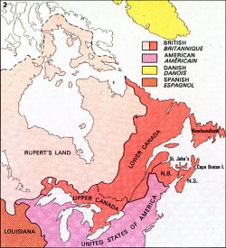
1791-1840

Slide 3
Terms of the Constitutional Act
In order to accommodate the American Loyalists, Great Britain replaced the Quebec Act with the Constitutional Act.
maintained French civil laws in Lower Canada however both provinces were governed by the English criminal code.
The Act also guaranteed the French people their rights to the Roman Catholic Church.

Slide 4
The Constitutional Act
divided the colony of The Province of Quebec into two new provinces:
Lower Canada and Upper Canada.
Created a new structure of government for each province (see diagram). It included, for the first time in Canada's history, a legislative assembly, the members of which were elected by the people.
The result was representative but not responsible government since the governor-general could veto or refuse bills passed by the elected legislative assembly.

Slide 5
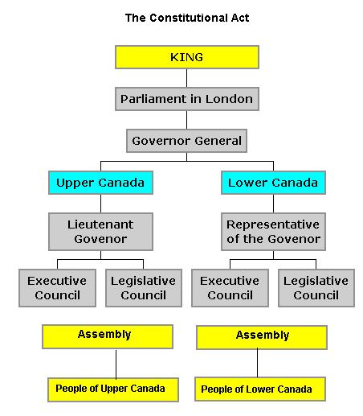
Form of the Constitutional Act
Parliament in London
Parliament in London
Governor: head of Government, Can Veto Legislative assembly, Selects Executive and Legislative councils
Executive council: suggest direction to Governor they were NOT elected
Legislative council: Help the governor to create laws, they were NOT elected, could veto Legislative Assembly Suggestions
Legislative Assembly: Voted in by people, had no power to control anything but taxation

