Slide 1
The Fur Trade
How the Beaver started Canada

Slide 2
Natives and the Fur trade
The natives were absolutely necessary to the fur trade
This forced Europeans to treat the natives with a certain amount of consideration
However this partnership had more negative effects than positive for the native people
This was caused by indirect causes such as disease, increased warfare, an attack on aboriginal religion and eventually as fur trade declines the European settling of native lands

Slide 3
Alliances
New France owed its birth to the Fur Trade
The natives (Algonquians) who controlled the area around modern day Quebec were powerful
In 1608 Champlain agrees to be their military ally vs. the Iroquois this alliance led to direct contact with the Algonquians’ Huron allies
The Huron became partners with the Algonquian and the Montegnais in a military/commercial alliance
This leads to a polarization between European and Native forces

Slide 4
Champlain VS Iroquois

Slide 5
What were the territorial consequences of the fur trade on New France?
The most important territorial consequence for New France was the growth of its territory
Over a period of one hundred fifty years New France's territory spread from a tiny colony on the St. Lawrence River to one that extended from the Atlantic to the Prairies, and from the lands surrounding Hudson Bay to the Gulf of Mexico.
The demands of the fur trade and missionary zeal led to the exploration of the continent by explorers such as Jolliet and Marquette, La Verendrye, LaSalle, Father Albanel and Radisson.

Slide 6
River transportation is the key to Exploration

Slide 7
Additional territorial Consequences
The expansion of New France's territory also brought about the encirclement of the English colonies.
The English felt threatened by this since their own expansion westwards and their access to fur resources was now limited .
This as well leads to numerous battles and wars and to the eventual conquest of New France by the English in 1760

Slide 8
Encirclement

Slide 9
What were the Military consequences of the fur trade on New France?
The fur trade brought about a series of alliances with the Native populations.
The French allied themselves with the Hurons and Algonquians while the Dutch, and later the English, allied themselves with the Iroquois.
This led to numerous battles and skirmishes between the Europeans and their Native allies over the control of the fur trade.
In 1649, the Hurons were destroyed by the Iroquois forcing the French to use coureurs de bois as their middlemen in the fur trade.

Slide 10
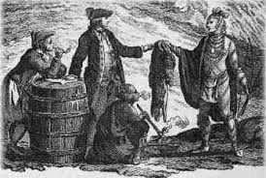
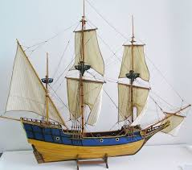
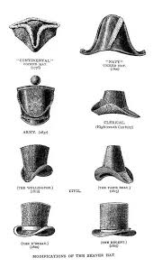
Structure of the Fur Trade
Algonquian collect fur
Huron trade with Algonquian and then trade fur to Europeans making them the middle men of the fur trade(replaced by coureur du bois later
Ship pelts to Europe
Pelts made into finished goods and sold back to New France and other countries

Slide 11
Which factors affected the first settlements of New France?
Economic Factors
Quebec:
It was the fur trade which first attracted the French to the St. Lawrence River Valley.
Champlain founded the first permanent settlement at Quebec in 1608 to establish a fur trade network with the Native population.
Trois-Rivieres:
In 1634, Champlain sent Laviolette to found Trois-R iv ieres, in order to be closer to the fur supplies.
Thus, the first two settlements, Quebec and Trois-Rivieres, were founded for economic reasons dealing with the fur trade.

Slide 12
Which factors affected the first settlements of New France?
Religious Factors. Montreal:
In 1642, Paul de Chomedv de Maisonneuve, assisted by Jeanne Mance, founded Ville-Marie (present day Montreal) in order to establish a religious mission to convert the Indians.

