Slide 1
What is Literature? Why do we study it?

Slide 2
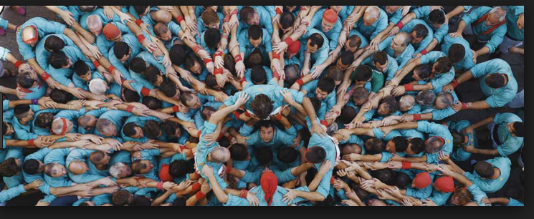
Purpose of Literature
Stories have been a part of the human condition since we sat around in caves telling stories to each other
It transmits our culture to the next generation
Connects us through shared experiences and ideas and allows us to see the beauty in the world
It makes us human

Slide 3
Genres
Imaginative literature
Prose Fiction
Poetry
Drama
Non-Fiction
Non-fiction prose

Slide 4
Prose Fiction
ALSO KNOWN AS NARRATIVE FICTION
INCLUDES MYTHS, PARABLES, ROMANCES, NOVELS AND SHORT STORIES
Fiction means created or crafted
They focus on a main character who changes or grows within the narrative
Its main purpose is to interest, stimulate, and create meaning through the journey the character takes through their point of view

Slide 5
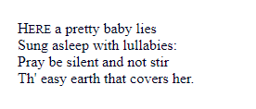
Poetry
Poetry expresses a monologue or a conversation grounded in the most deeply felt experiences of human beings
Uses a lot less words than prose fiction but can deliver deep meanings through its use of techniques
Poetry relies heavily on imagery, figurative language and sound
It is the most reliant on the readers previous knowledge and experience

Slide 6
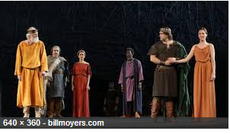
Drama
Designed to be performed
Its message is delivered through fictional events that the audience becomes a witness too
They are often prose but can also be delivered in poetic form
Prose is a reflection of the common language in writing

Slide 7
Non-Fiction Prose
Consists of news reports. Articles, essays, editorials, text books, histories and biographies
All of which describe or interpret facts, and present judgements and opinions
The goal is to present truths and SOUND CONCLUSIONS about the factual world

Slide 8
Reading Literature
First readings do not provide full understanding
In order to answer pointed questions we need to do a deeper reading
We need to question and understand the ideas within the literature through the lens of our own lives
We need to search for techniques and elements to figure out the ideas that the author is focused on
While using our own lives to decide if these points are valid

