Slide 1
WWII and the Home Front

Slide 2
War Time Production
Wartime production By the end of the war Canada had produced:
16, 000 aircraft
741 naval vessels
800,000 transport vehicles
55,000 tanks and armoured vehicles
149,000 heavy guns,
133 million rounds of heavy ammunition an d 5 billion rounds for small arms
This production helped the depression end faster than it would have.

Slide 3
Economy at Home
In 1942 rationing (fixed amounts in time of scarcity or war) came about- butter, coffee, sugar, meat, and gasoline were some of the items that were rationed
Rubber, glass, old saucepans and tooth paste tubes (aluminum) were recycled for military production
Government controlled prices and wages to prevent inflation. The federal government centralized control over production by taking control over resources from the provinces
Income tax rates were raised to pay for the war effort.
Canadians were urged to buy Victory Bonds, War Savings Certificates and stamps to help raise money. By the end of the war, Canadians poured 8.8 billion dollars into the effort

Slide 4
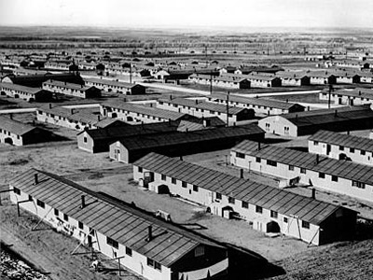
Limiting Freedom at Home
For the sake of national security, the Canadian government, through the War Measures Act, was empowered to institute censorship, allow search without warrant and impose restrictions on individual liberties.
With Japan entering the war in 1941, Japanese Canadians in British Columbia had their property seized and thousands were evacuated to internment camps because they were considered a threat to national security. They stayed in the camps until the end of the war

Slide 5
Women in the Work Force
Women played a major role on the home front and in the armed services
The labour shortage caused by the war drew more women into the labour force
The slogan "from the kitchen to the factory" described the changes that women underwent during the war years.

Slide 6
Women in the Workforce
In 1939, 569, 000 women worked in Canadian industry, mostly at clerical jobs.
In 1944, 960, 000 were in war and civilian factory jobs plus another 800, 000 worked on farms.

Slide 7
Conscription Crisis WWII
Conscription is compulsory military service.
The conscription issue of 1917 deeply divided Canadians.
In 1939, after Canada had declared war on Germany,. English Canada supported sending troops to help Britain and France, French Canada did not.
Prime Minister King, fearful of dividing the country and his own government, promises the Quebec population during the provincial elections of 1939, that his government would not impose conscription during the war. Only volunteers would be sent overseas.

Slide 8
Broken Promises
By 1942, the volunteer system could not maintain the strength of the armed forces.
King was under considerable pressure from the military to bring in conscription.
To release his government from his commitment to Quebec King decides to hold a plebiscite (a direct vote on a question of national importance) on the issue.
On April 27, 1942 the Canadian population was asked to vote yes or no on the following question:
Are you in favour of releasing the government from any obligation arising out of any past commitments restricting the methods of raising men for military service'? YES___ NO___

Slide 9
Results of the Plebiscite
In Quebec, 71.2% of the population voted no, against conscription.
In English Canada, 77% voted yes in favour of conscription.
Across Canada 63% voted in favour of approving conscription
The results once again showed the divisions between English and French Canada.
Prime Minister King, mindful of this division, delays using conscription for overseas service until 1944, when 13,000 men were sent to Europe.

